Slide 1
FortiSOAR Deep Dive - NOC

Slide 2
Agenda
What is SOAR?
Why FortiSOAR?
FortiSOAR Architecture
FortiSOAR Overview
Proof of Concepts
Resources

Slide 3
What is SOAR?
Security Orchestration, Automation, and Response to alerts and incidents to accelerate investigations and responses
Security Orchestration
Integration with all of the possible security tools used in an organisation to enable a seamless and integrated response to incidents
Security Automation
Eliminate manual, repetitive, time-consuming, and tedious tasks and processes by automating them, enabling faster, and consistent completion
Security Response
Through the use of orchestration and automation, the response actions can be standardised, eliminating human error, and enabling faster responses to incidents

Slide 4
Typical Security Operation Challenges
Volume of Alarms
Develops alert fatigue
Manual processes
Complex and lengthy workflows produce slow response times, prone to human error & burnout analysts
Human Error
Whether due to skill set or inattention, human error is still at the heart of several breaches
Limited Budget
Organizations are struggling with retaining and acquiring senior level staff
Siloed Security tools
Lack of infrastructure integration can considerably slow down incident response
Notes:
A) Volume of Alarms:
According to a recently released report conducted by International Data Corporation (IDC) for Critical Start, a cybersecurity consulting and managed detection and response company. IDC surveyed more than 300 U.S.-based IT executives at companies with 500 or more employees. It found that:
Security staff spend an average of 30minutes for each actionable alert, while 32 minutes are lost chasing each false lead.
Companies with 500-1,499 employees ignore or don’t investigate 27% of all alerts.
The figure is nearly a third (30%) for companies with 1,500-4,999 employees and 23% for those with 5,000 or more employees.
B) Manual processes
According to IBM (Cost of a Data Breach Report 2019) average time to contain a breach was 73 days
C) Human Error:
First American Financial Corporation Data Breach
Date: May 2019
Impact: 885 million users
In May 2019, First American Financial Corporation reportedly leaked 885 million users' sensitive records that date back more than 16 years, including bank account records, social security numbers, wire transactions, and other mortgage paperwork. The leak occurred through a website configuration error, allowing the public to view sensitive information without needing any authentication. Because First American's records were sequential, anyone could increase or decrease the number in the URL to quickly view another customer's records. Despite the massive leak, there were no reports of any customer information being stolen and used for malicious purposes
Fortinet Annual Skills Gap Report Uncovers an Increase in Breaches Attributed to a Lack of Cybersecurity Skills
E) Siloed Security Tools:

Slide 5
What is SOAR?
SIRP
TIP
SOAR is a combination of 3 technologies
SOA : Security Orchestration and Automation
SIRP : Security Incident Response Platform
TIP : Threat Intelligence Platform
SOA
SOAR : Security Orchestration, Automation and Response

Slide 6
Security Orchestration, Automation, and Response
SOAR is a tool that enables the collection of data about cybersecurity threats, and the ability to respond to security events (alerts/incidents), with little or no human assistance.
SOAR achieves this via Security Orchestration by connecting to and integrating disparate internal and external tools via built-in or custom integrations and APIs. These tools include, but are not limited to, SIEMs, firewalls, IDSs/IPSs, endpoint security systems, threat intelligence feeds, and other third party systems.
Through the use of Security Automation the ingestion and analysis of alerts and data is automated, replacing repeatable manual tasks and processes. This enables faster and consistent completion of these tasks and processes, while allowing for elevation to human intervention
Then through SOAR’s orchestration and automation, it can perform a Security Response to an event by collaborating with the tools to block or remediate the detected threat, or share threat intelligence with them. This enables a comprehensive response to events.

Slide 7


Reduces Alert Fatigue
Manual
SOAR
Dozens of tickets per day
Analysts can only spare few minutes per ticket
Case management quality issues
Does most of Tier1 staff workload
Only a fraction of tickets are escalated
Cases are properly investigated
Notes:
- Tier 1 can be replaced almost entirely $$$

Slide 8
Automation & Orchestration
Manual
SOAR
Without automation the workflows can be slow which impacts the operational efficiency
Manually orchestrating several tasks can be exhausting and prone to errors
Integrates with the entire IT/OT Orchestrates workflows spanning across all departments and network segments
Handles several parallel tasks and manage their dependencies
Isn’t prone to human errors
Notes:
- 550+ integration with a dedicated team
- Can’t have a typo with an IP or forgets to commit a configuration after it’s changed

Slide 9
Response Time
Manual
SOAR
Much slower
Slow response means high breach impact
Responds in few seconds
Multi-Tasking
Mitigates breach impact and data loss by breaking the kill-chain at an early stage
Notes:
- having few seconds only, attacker won’t have time to gain persitance and lateral movement

Slide 10
Addresses The Skill Gap
Manual
SOAR
Shortage of highly skilled SOC analysts
SOC team must be trained on every system they operate on
The unified UI allows analysts to perform any task without prior knowledge of the third-party technology.
With SOAR analysts can operate as Tier2 without extensive products experience
Notes:
- having few seconds only, attacker won’t have time to gain persitance and lateral movement

Slide 11


Visibility
Manual
SOAR
NOC Reporting
OT Infrastructure
Email Security Reporting
SIEM Reporting

Slide 12
SIEM vs SOAR
SIEM and SOAR are separate but complimentary products. SIEM focusses on data ingestion (primarily logs), aggregation, and alerting. SOAR focusses on alert ingestion and aggregation, threat aggregation, automating alert analysis (using enrichment, etc), and orchestrating a comprehensive security response.
 | SIEM | SOAR
Integration | Focuses on collecting data from various network devices and systems. | Integrates all security tools, systems, and applications in an organisation to automate incident response workflows.
Data Aggregation | Aggregates log data | Aggregates security alerts and threat intelligence
Data Processing | Analyses data to identify potential threats | Enriches and correlates alerts to determine risk
Alert Processing | Generates alerts | Ingests Alerts from SIEM and other tools
Incident Response | Limited response workflows | End-to-End, automated-powered response workflows
Orchestration Capabilities | Notifies users and analysts of suspicious activity | Orchestrates actions across integrated tools
Main Benefit | Correlates and makes sense of large amounts of log data in order to identifies patterns and trends. Supports compliance and audit use cases. Provides historical context for incident response. | Provides a comprehensive response mechanism using playbooks that can be fully automated or manually executed. Generates dashboards and reports on security incidents.
Effect on SecOps | Increases the amount of detectable incidents but might produce more alerts than can be practically responded to. | Enables the security team to efficiently handle a high alert load and focuses them on specialized tasks, resulting in a higher-performing SOC.
Note: Gartner has made a comment about SIEM vendors building SOAR into their solutions, so there may be a consolidation of SIEM and SOAR in the future.

Slide 13

















Security Operation Platform
External Attack Surface & Dark Web
Detect & Disrupt
cyberattacks with AI and integration
applied within a specific domain and across domains
Applications
Investigate & Remediate
through orchestration, automation and/or staff augmentation
FortiRecon
Threat Analytics
FortiSIEM
FortiSOAR
FortiDeceptor
FortiSandbox
Users & Devices
FortiMail
FortiEDR
Email
FortiAnalyzer
AI Security Engines
Detect constantly evolving threats
6th generation over 10 years
100 cyber security applications
FortiNDR
Networks
Security Services
Keep pace with threat landscape
Cyber threat intelligence
Expert augmentation

Slide 14
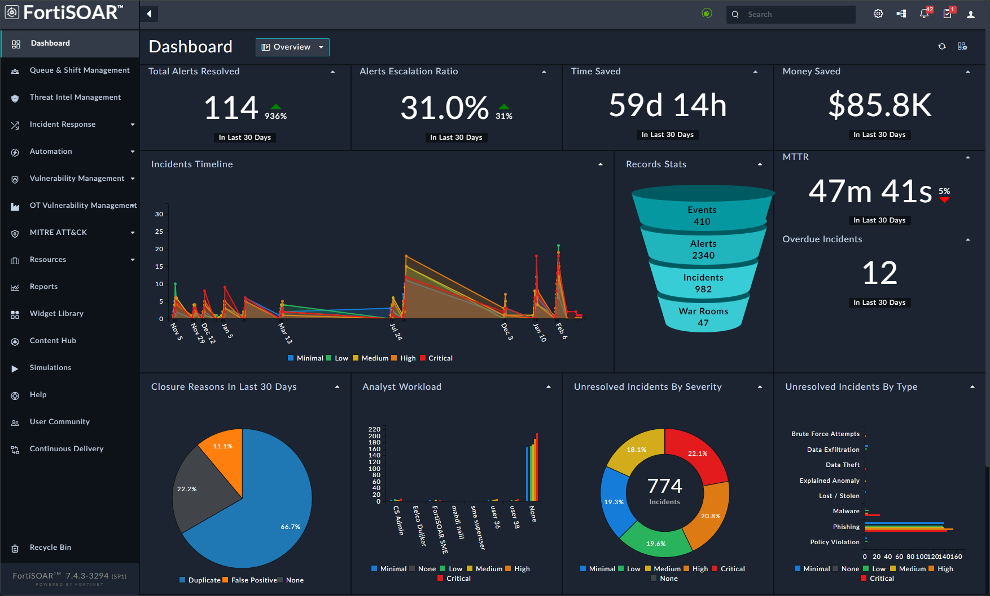

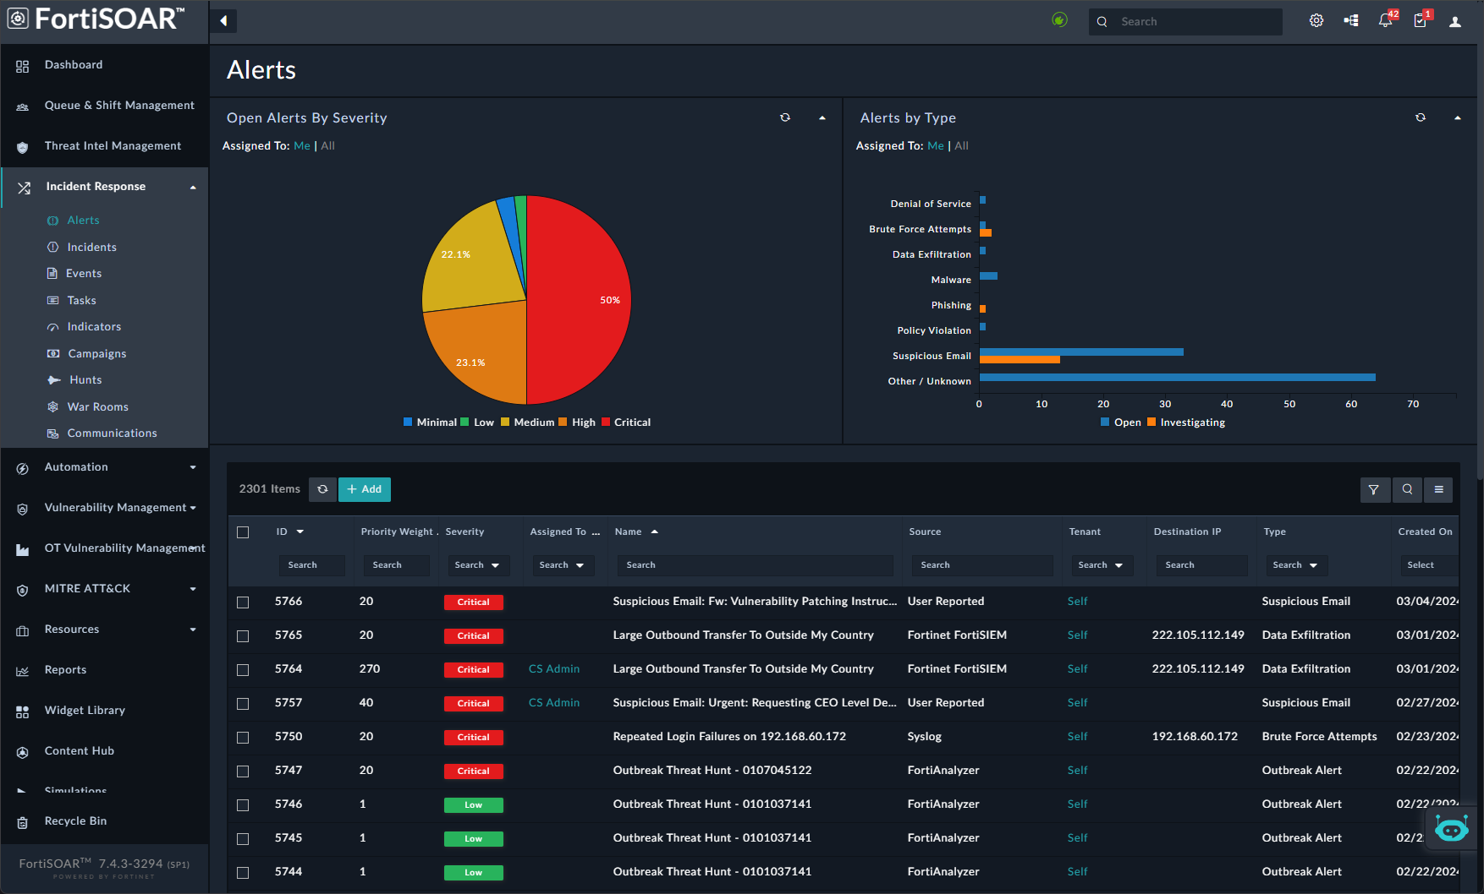



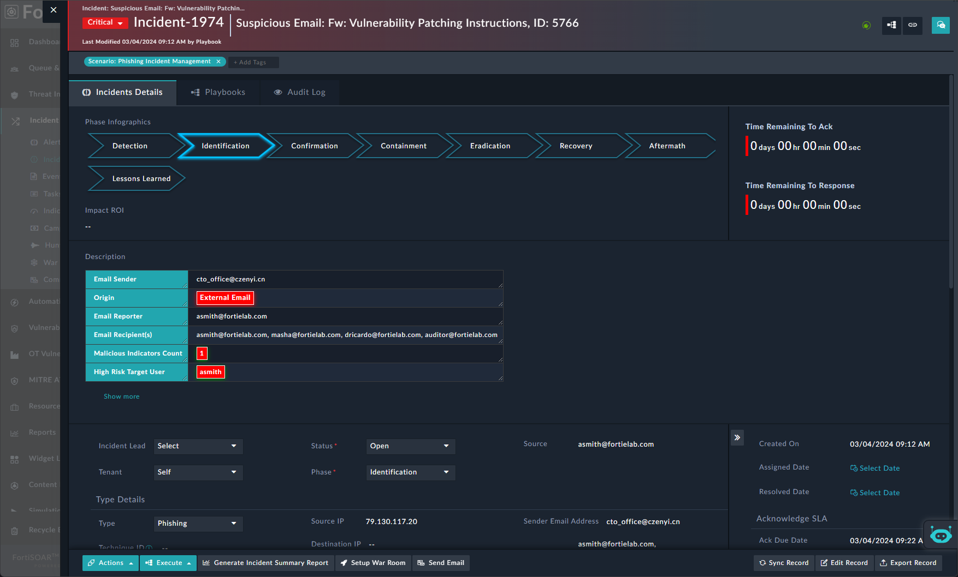




















FortiSOAR: Overview
A Security Orchestration, Automation an
Response (SOAR) solution that enables
security teams to centralise incident
management and automate the myriad of analyst activities required for effective threat investigation and response.
FortiSOAR
Automated Orchestrated
Response Platform
SaaS
Virtual Appliance
Security Fabric Integrations
FortiGate
FortiAuthenticator
FortiAnalyzer
FortiClient
FortiCWP
FortiDDOS
FortiDeceptor
FortiEDR
FortiGuard
FortiMail
FortiManager
FortiMonitor
FortiNAC
FortiNDR
FortiProxy
FortiRecon
FortiSandbox
FortiSIEM
FortiVoice
FortiWeb

Slide 15

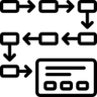
What is FortiSOAR:
Security Orchestration, Automation, and Response
An automation platform that
SOAR Platform
Connects to virtually any app, system, or data source
Threat Investigation
Incident
Response
Collaboration
& Case Mgmt
Threat Intel Mgmt
Workforce
& SecOps
Mgmt
Executes any sequence of actions via defined playbooks
SecOps Use Case Solutions
Supports a set of user “solutions” for important SecOps activities
Pre-built Playbook Library
Automation
Engine
Custom
Playbook Builder
Extends to automate NOC or virtually any other function
Bi-Directional Connectors
IT Security
Sources
OT Security
Sources
Any
Application
Any
Data Source
Notes:
Use this slide and next slide up front if customer may not be familiar with what SOAR is
Our product, FortiSOAR, is really a process or workflow automation platform, especially attuned to automating Security and IT operations.
It connects to virtually any source and can uses playbooks or workflow definitions if you prefer, to automate tasks involved in typical security, IT or other enterprise operations. We provide over 800 of these playbooks and make it simple to create or customize your own.
You can use the platform to automate anything you choose.
But on top of this platform we have built out complete solutions for essential security analyst functions. You can think of them as SecOps use cases. These solutions are optimized for efficiency by using AI and the automation capabilities of the platform.
Security analysts spend their time investigating and responding to priority threats, working together to track and close out incidents, and constantly make use of critical vulnerability and threat intelligence to assess and react to attacks.
Finally, we add in Workforce management, SLA management and other operations features.
With these solutions and broad capability, FortiSOAR is ready to be the backbone of security operations.

Slide 16
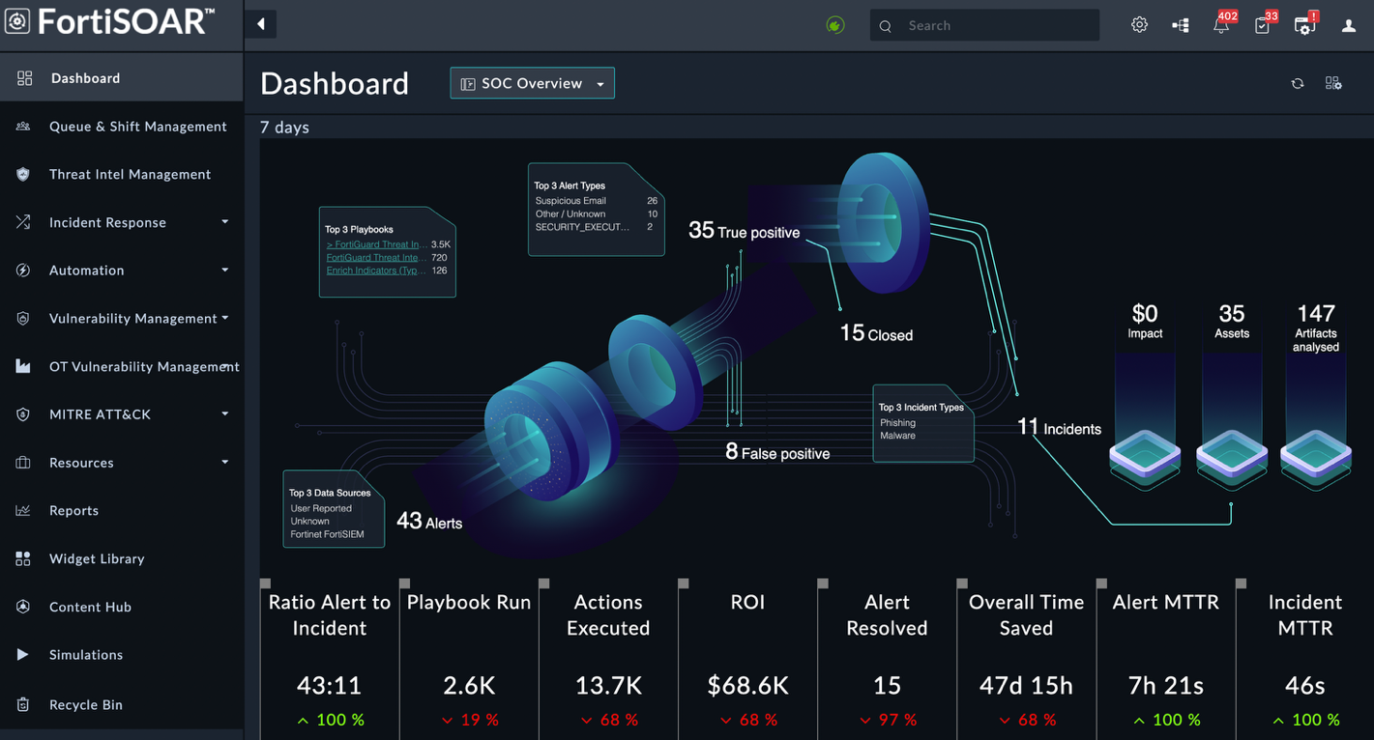
FortiSOAR by the Numbers
On Prem
FortiCloud
Public Clouds
Containers
Respond 98% Faster Than Manual Operations with Orchestration & Automation
Supports analysts with AI based machine assistance, while retaining human control
Provides advanced orchestration & automation to improve efficiency, creating consistency, and accelerated response times
FortiSOAR Out of the Box Highlights:
550+ Integrations with more being added regularly
50+ Solution packs to handle various use cases
850+ Use case playbooks
Several thousands of integration sample playbooks
FortiGuard Threat Intelligence Included​
Advanced Case Management
Advanced product customization

Slide 17














Key FortiSOAR Elements (and Focus Areas)
Form Factors / Licensing
VM and Cloud (Enterprise / SP Ready)
Agnostic (Multi-Vendor )
Multi-Tenant
Best Practice Services
Investigation & Response
Efficiently investigate alerts/incidents Understand, review and manage incidents
  Crisis Response (War Room)
  Mobile Application
Automatic tasking across multiple queues and teams
FortiSOAR in The Cloud
Multi-tenancy support
Flexible deployments
  Enterprise
  Shared tenancy
Auto-firmware upgrade/health monitoring
Simple licensing model
Advanced Orchestration & Automation
Easily build advanced automation to create workflows and integrate into existing tools
AI-Based Recommendation Engine
Playbook and Connector Builder
Content packs
Container in FMG/FAZ
KPI Measuring & Reporting
Quickly identify SOC KPI’s (MTTR, analyst time savings) and reporting for audits, leadership etc
Role-Based Access Control
Built-in visual dashboard enabling easy creation of dashboards specific to a role in and outside the SOC
Control access to connector actions, configurations and Playbook
Concurrent Model
Threat Intelligence Management
Deep FortiGuard integration, provides unrestricted lookup and Threat Encyclopedia access within the Indicator module

Slide 18
Reduce Operational Cost
Each automated workflow increases the ROI
  An example small automated environment, assuming a cost of 50$/hour per analyst:
6,450 minutes would be 107.5 hours, the equivalent of 13.5 analysts doing 8 hour days.
Total saving: $1,961,875 per annum
Action | Time Taken (mins) | # of Times per Day | Total Time (mins) | Total Cost per Day
An indicator enrichment | 10 | 500 | 5,000 | $4,167
Triage and escalation | 10 | 100 | 1,000 | $833
Users and assets enrichment | 15 | 20 | 300 | $250
Incident containment and response | 30 | 5 | 150 | $125
Totals |  |  | 6,450 | $5,375

Slide 19
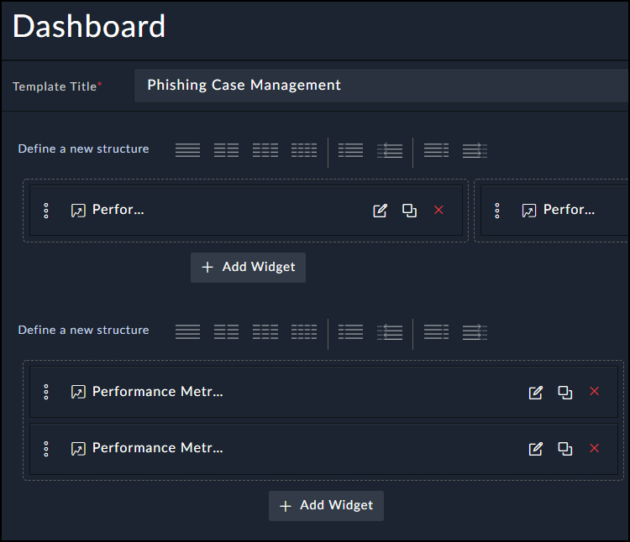
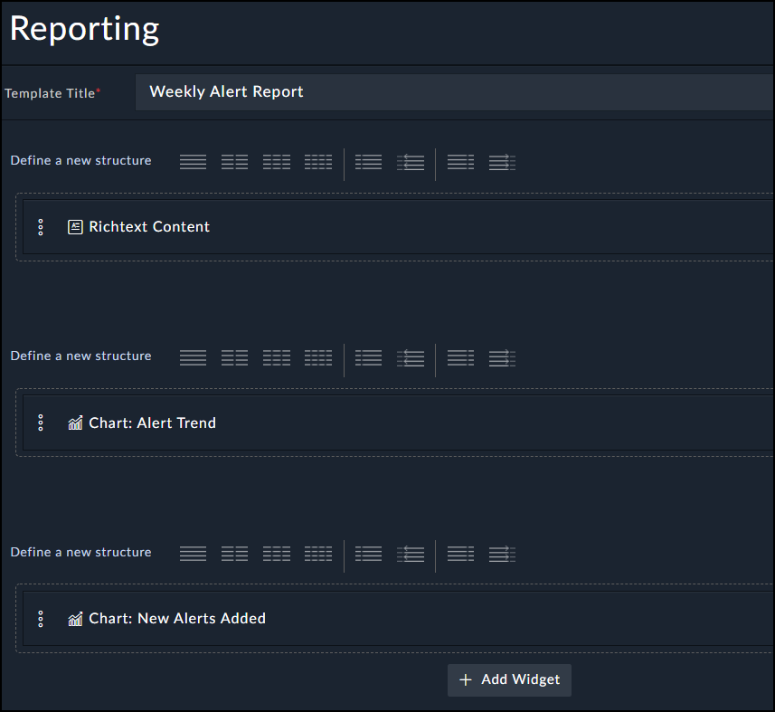
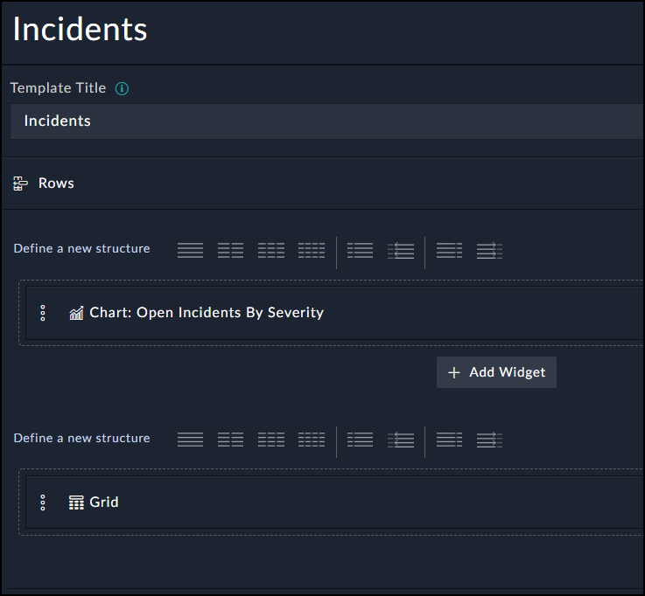
Flexibility & Customizability: View Template
Dashboards, Reports and even the web interface itself has customizable view templates allowing you to design your own UI
19+ Widgets to choose from to populate your dashboards, reports and UI itself, from charts to records lists, counts and many more. The system allows also IFrames so you can add an external web pages to your view templates
The system supports custom widgets that you can build using the wizard and deploy locally or share it with FortiSOAR community
Reference: https://www.gartner.com/reviews/market/security-orchestration-automation-and-response-solutions/vendor/fortinet/product/fortisoar

Slide 20
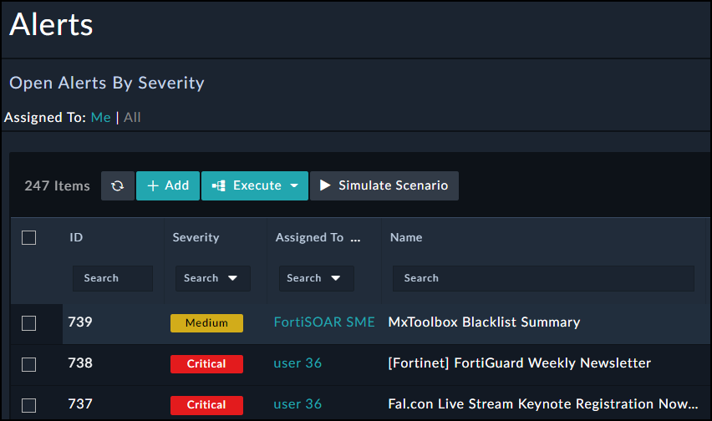
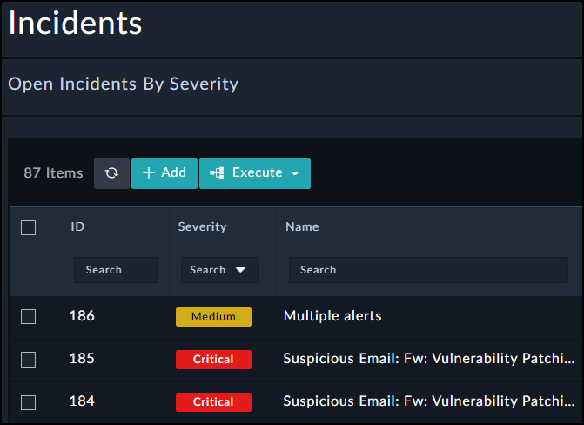
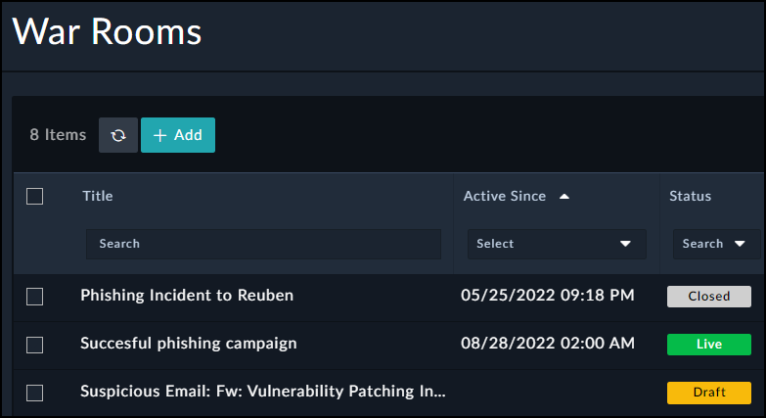
Comprehensive Case management
One to One mapping between your human organization and soar tickets data structures
Case Management goes beyond Cyber Incident Response to cover any source of incidents including:
  Network Monitoring
  Human Resources
  System Monitoring and many more.
Integrations with most Ticketing Systems (ITSM) ensures the case management workflow extends across all IT departments
Crisis management via War Rooms streamlining stakeholders' collaboration
Reference: https://www.gartner.com/reviews/market/security-orchestration-automation-and-response-solutions/vendor/fortinet/product/fortisoar
Notes:
Most SOARs from the competition do not handle anything beside cyber security incident response cases

Slide 21

Automation Beyond SOC
Sample Use Cases
Certificates Management
NGFW Zero Touch Provisioning
Employee Offboarding
OT Vulnerability Management
OT Assets Management
Compliance Management
Shadow IT Mitigation
Knowledge Base
Notes:
Periodic Indicators Ingestion:
Manually Parse Indicators from Email > Format it for destination devices (Firewalls, Proxies…) > Upload the lists to Firewalls
Disable Access for employees who left the company:
Get the list from HR > Lookup their access > Connect to each service and disable it
Automate Daily, Weekly and Monthly reporting:
Compile reports from various techs > Send it to a Set of recipients
Automate vulnerability management:
Schedule scans > Parse scan results > Create/Attach Vulnerabilities to assets > Patch Assets
Detect un-enrolled employees on UEM:
Get assets report from UEM like workspace one, Evanti. > Compare with network traffic > deduct unenrolled ones

Slide 22

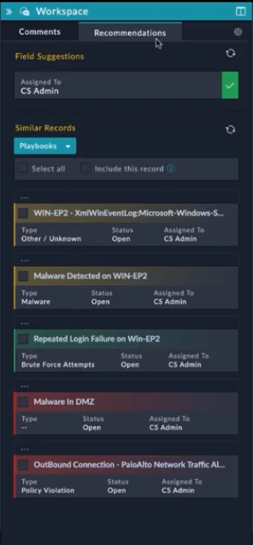
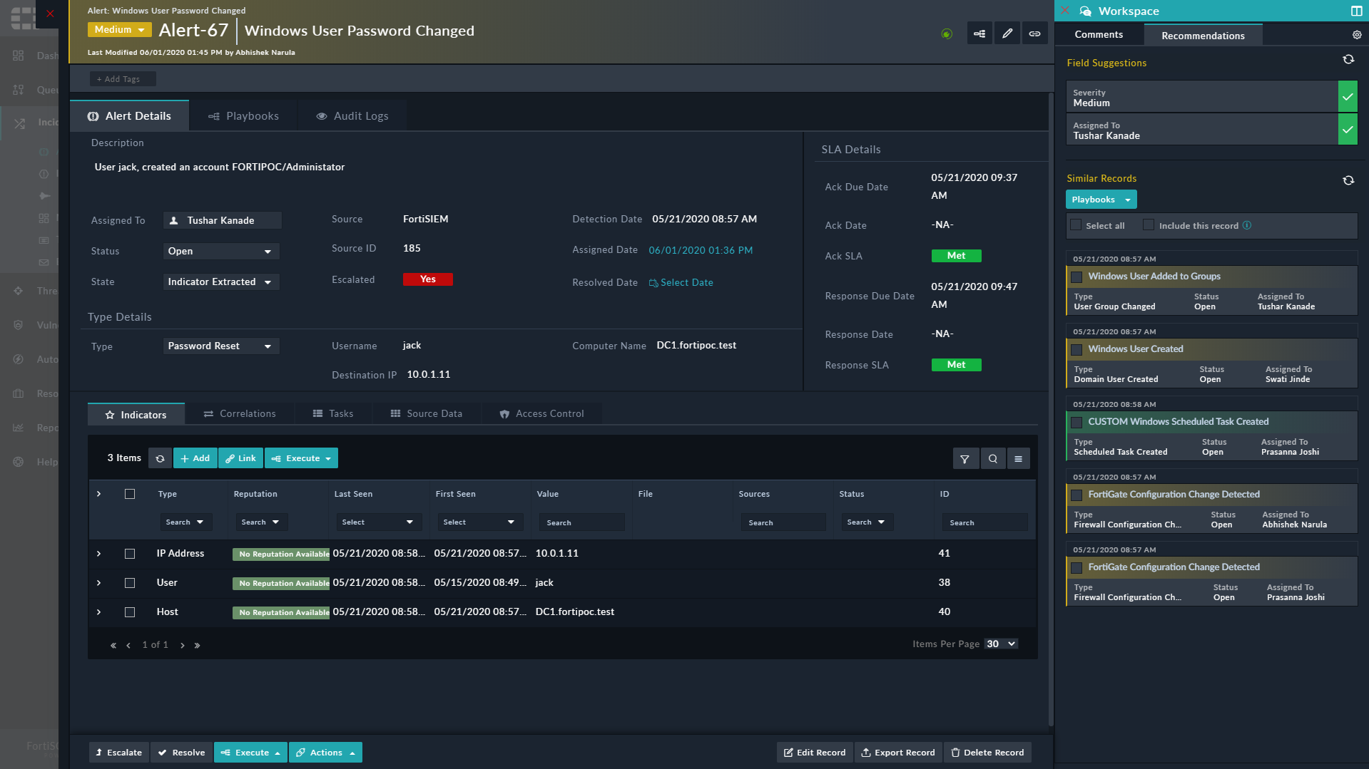
Alert Triage Automation
1
Streamline Investigations
AI-driven prioritization that dynamically detects false positives, and automatically group similar alerts and incidents to present a consolidated timeline for investigations
2
Automatically Enrich & Correlate Alerts
Reduce time spent investigating alerts through FortiSOAR’s recommendation engine, that provides analysts with suggested actions, correlated alerts & critical data, enabling quick decision making
3
Proactively Respond
Control how data is processed by dictating what algorithm fits internal best practices

Slide 23
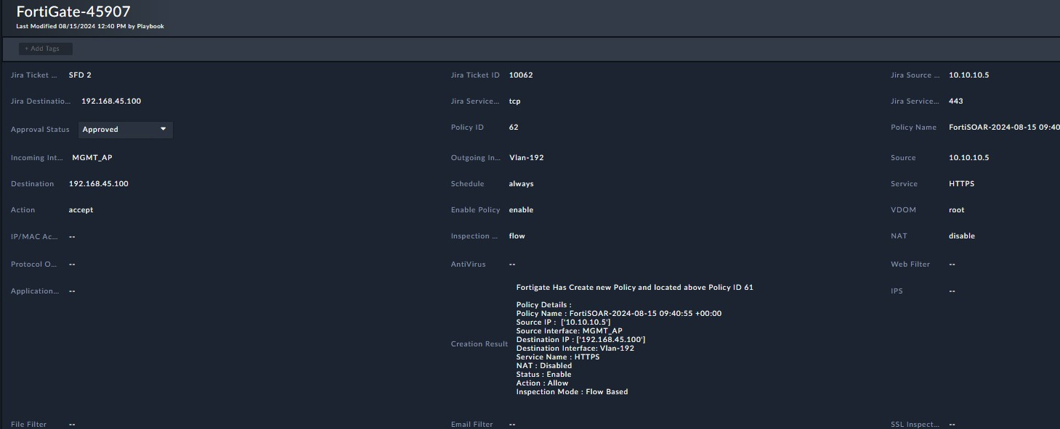
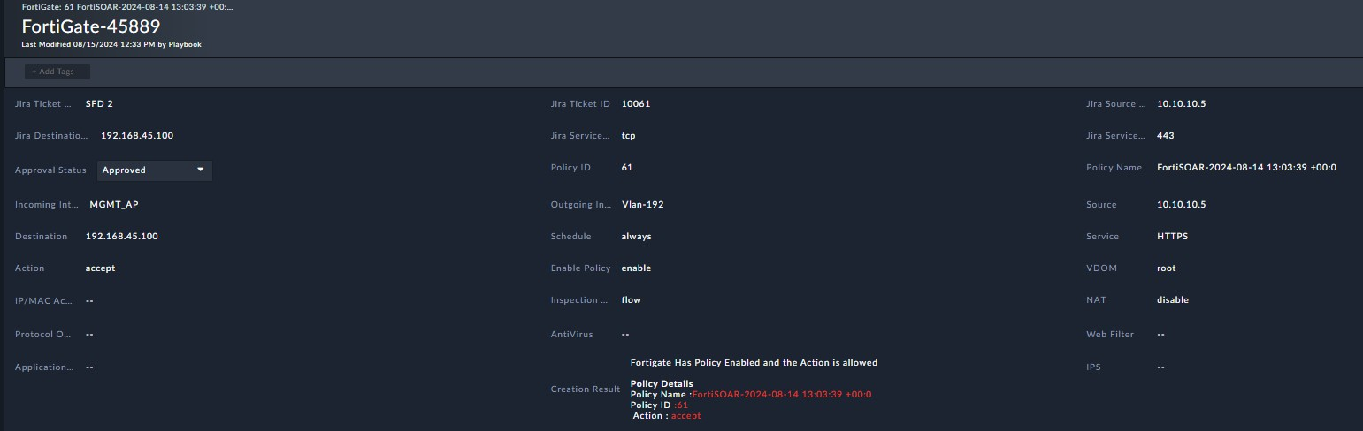

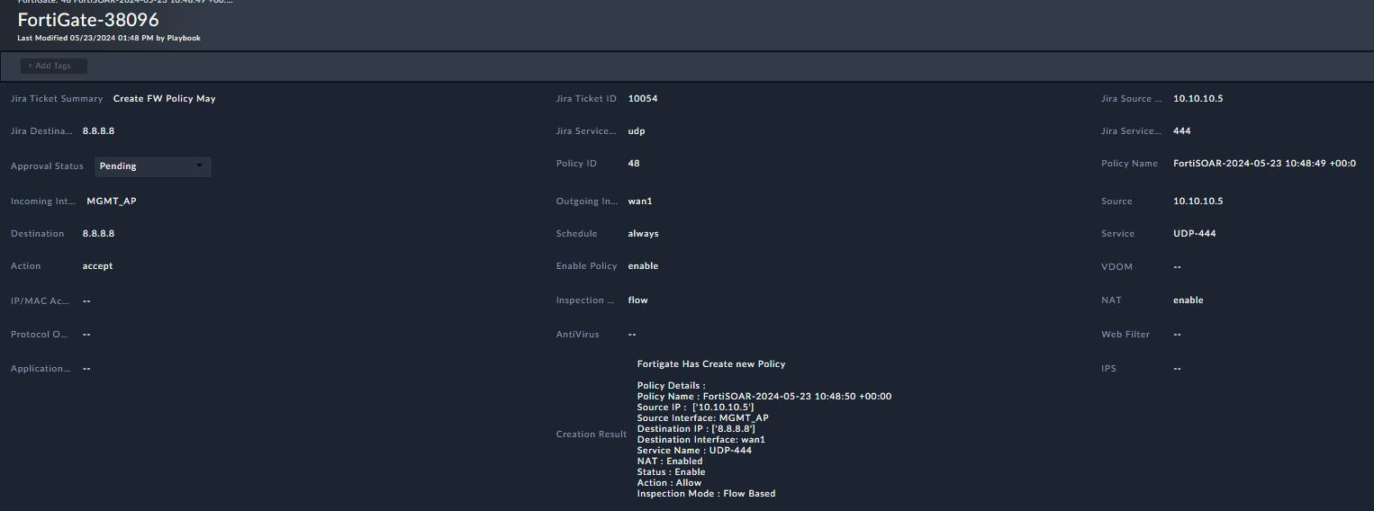


Policy Creation
NOC Workflow Automation
Firewall Policy Workflow
Request Check
Add | Modify
Optimize
Document
Address Service Policy
Existing Denied New
Policy Optimization
Policy
Scheduled Timeout
Permit
Requester Approver Auditing

Slide 24
VPN Creation for Contractors
NOC Workflow Automation
Supervisor
Request
VPN Workflow
Request
Approval
Create VPN
User
Optimize
Document
Manager
Approval
Create User and
provide access
Address Service Policy
Confirm Approval
from All Managers
Revoke Permission once the permission expire
Create Users and add
to policy
Auditing Request
Revoke Permission
Document
Request

Slide 25
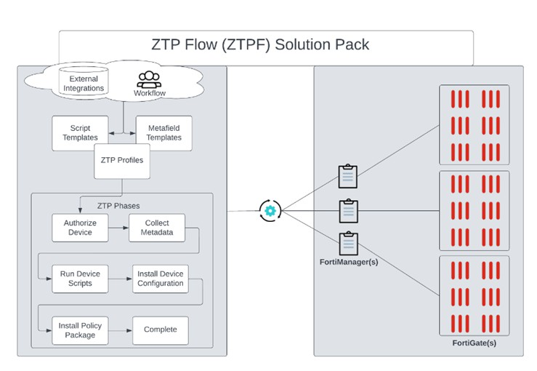
Zero Touch provisioning

Slide 26






USB Management System
Business Use Case Workflow Automation
USB Access Workflow
Request Verify
Approval
Apply
Remove
USB Access
Requester Email Machine Manager
USB Allowed Grp
FortiEDR
Manager Approval Justification Time Period
Timeout Remove Access Update

Slide 27


Automated Employee Onboarding
Business Use Case Workflow Automation
USB Access Workflow
Exchange
Request
Gathering informatio n
Approval
Apply
Active
Directory
Database
ITSM New Employee
Username Department Title
Create Username Assign to Specific Group
Create Mailbox Give Access to specific DB Give Access to
Specific Linux Server
ITSM
Linux
Server
IT Infrastructure

Slide 28
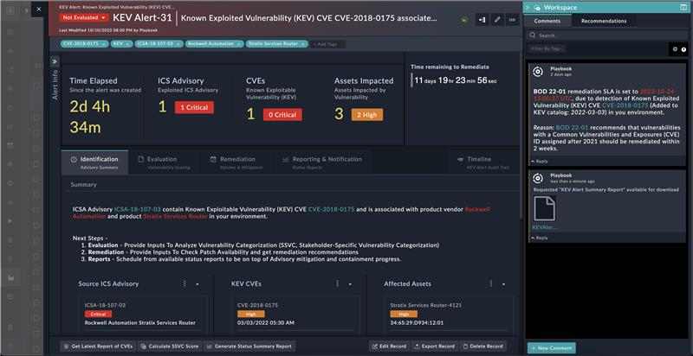
Compliance Automation
From hours to minutes,
again and again…
Automate costly compliance activities
Complete Solution Packs for: NIST, GDPR,
CISA BOD 22-01, …
FortiSOAR centralizes and automates frequent IT/OT compliance activities:
IOC advisory updates
Vulnerability management
Threat intelligence processing
Threat hunting
Tracking and reporting
Advisory Feed Automation
Automatically process mandatory IOC advisories
Execute proper updates across infrastructure
Generate compliance report
Vulnerability Management
Assign, automate, and track required tasks
Tracking, Validation, and Reporting
Solution Packs for required intel feeds, action playbooks, tracking dashboards, reports and more

Slide 29
Change Request on VMs
Business Use Case Workflow Automation
USB Access Workflow
VMWare
Request
Gathering informatio n
Approval
Apply
ITSM
Create VM Suspend VM snapshot
Execute Action Notify Requester Update ticket and close it
ITSM
Solution
Exhange
IT Infrastructure

Slide 30

High Level View of FortiSOAR’s Internal Architecture
FortiSOAR Platform
Task
Automation
& Recommendation AI Engine
Threat Investigation
& Response
Case Management
Collaboration
& Incident
War Room
FortiSOAR
Content Hub
Threat Intel Mgmt & Workspace
Asset & Vulnerability Mgmt
Workforce
& SLA Mgmt
Playbook &
Connector Builder
Bidirectional
Integrations
& Actions
Playbook
Execution Engine
IT/OT Alerts
Threat Intel
Feeds

Slide 31


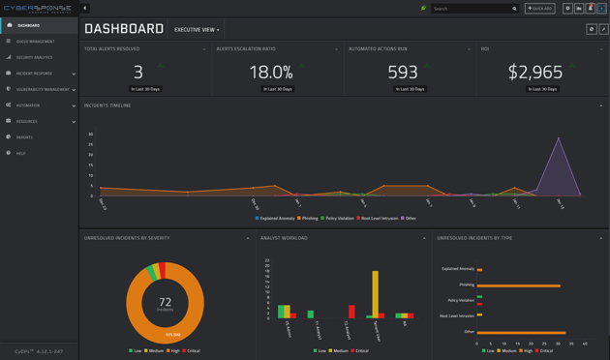





Enterprise Architecture
Database
Supports internal, or external database
Internal database asynchronously replicated between nodes
External database for greater resilience and scalability
Optional
Network A
Action Response
FortiSOAR Agent
Run Action
Action Response
Network B
FortiSOAR
Centralised hub for security operations
Active/Passive HA for resilience
Active/Active HA for resilience and scalability
Multiple secondary nodes supported
HA license required for high availability
Outbound connection to Secure Message Exchange
FortiSOAR Agent
FortiSOAR Agent
Lightweight component
Utilises outbound communication to Secure Message Exchange to enable FortiSOAR connectivity to segmented network
Enables automated ingestion, enrichment, and triage actions to segmented network
Requires no VPN or direct connectivity
FortiSOAR Secure Message Exchange (SMX)
Routes the request to appropriate agent
Guarantees secure delivery (whenever agent is alive)
TLS communication over TCP 5671
On Premises
FortiCloud
Public Clouds

Slide 32

High Availability and Scalability
Active/Passive with Internal DB
Active/Active with Internal DB
Active/Active with External DB
Other Clusters
Other Clusters
Other Clusters
SME
SME
SME
SME
DB
High Availability
SME
SME
SME Cluster
SME Cluster
SME Cluster
Active
Active
Active
Active
Active
Active
Active
Asynchronous Replication
Asynchronous Replication
Internal DB
Internal DB
Other Nodes
Internal DB
Internal DB
Primary
Node
Passive
Node
Primary
Node
Secondary
Node
Primary
Node
Secondary
Node
Secondary
Node
FortiSOAR Cluster
Load Balancer
Load Balancer
SOC Team
SOC Team
SOC Team

Slide 33
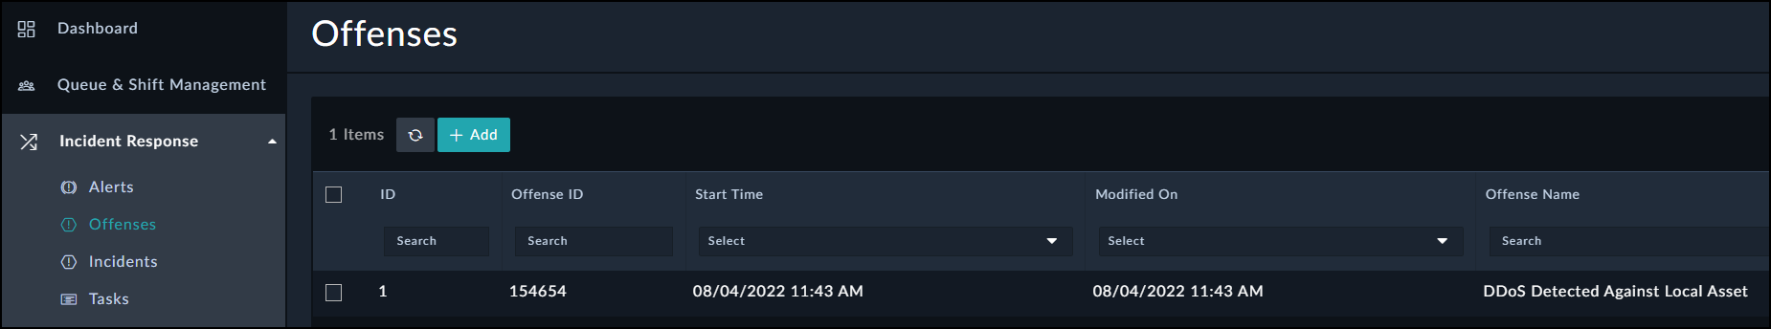
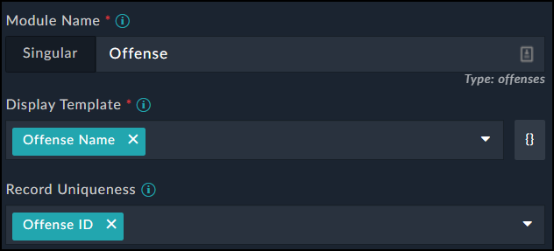
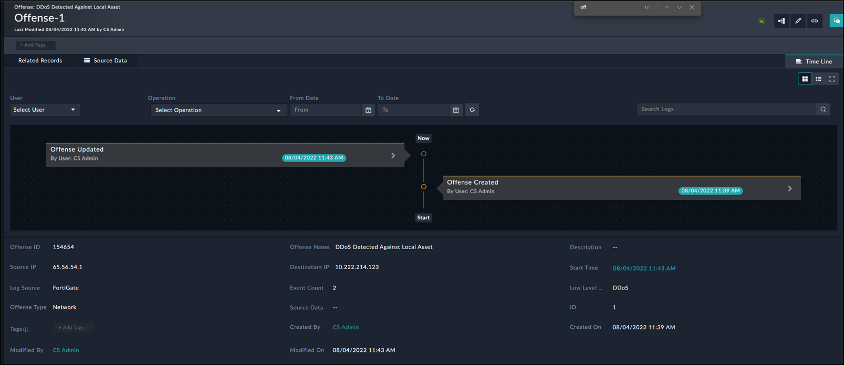
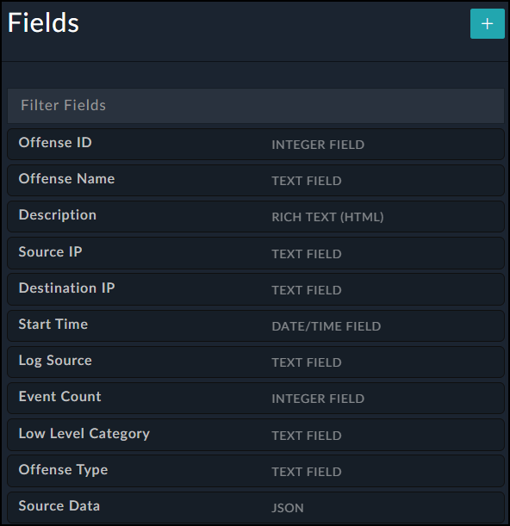
Records
Custom
Module
How Data is Stored in FortiSOAR
Custom Module
FortiSOAR’s data is stored in the database in Records.
The contents of each record is defined by it’s Module (Record Type), such as Alerts, or Indicators. Records contain multiple fields of various data types, i.e. text, integers, or JSON
Records can be customised, and custom records can be created to store any required data.
Record
Custom Module Fields

Slide 34
Record Types and Relationships
This is an example of the relationships
between some record types, showing
how they can be linked.
Incident
As shown, different records have different relationships, such as 1 to many (n), and many (n) to many (n).
1
SIEM Events
MITRE ATT&CK
n
n
1
n
n
War Room
Alert
Tasks
1
n
1
n
(Ticket)
n
1
n
Indicators
n
Attachments
n
n
Communications
Notes:
This component underpins the operational side of your SOC.
Alerts & Events: Alerts are related to events
Incidents
Incidents represent a collection of information discovered during an Incident Response investigation. Incidents are triggered based on the suspicion or confirmation of a security breach.
Indicators:
represent records that contain simple identifiable information regarding a threat such as an IP or URL
Emails
contain potentially malicious emails, such as phishing emails. FSR extracts and stores the Email Headers for further investigation. also creates an alert with a link to the email
MITRE ATT&CK Techniques module displays MITRE ATT&CK Techniques.
FSR contains some playbooks that pull these techniques. some playbooks that can classify alerts into the relevant MITRE ATT&CK Techniques.

Slide 35
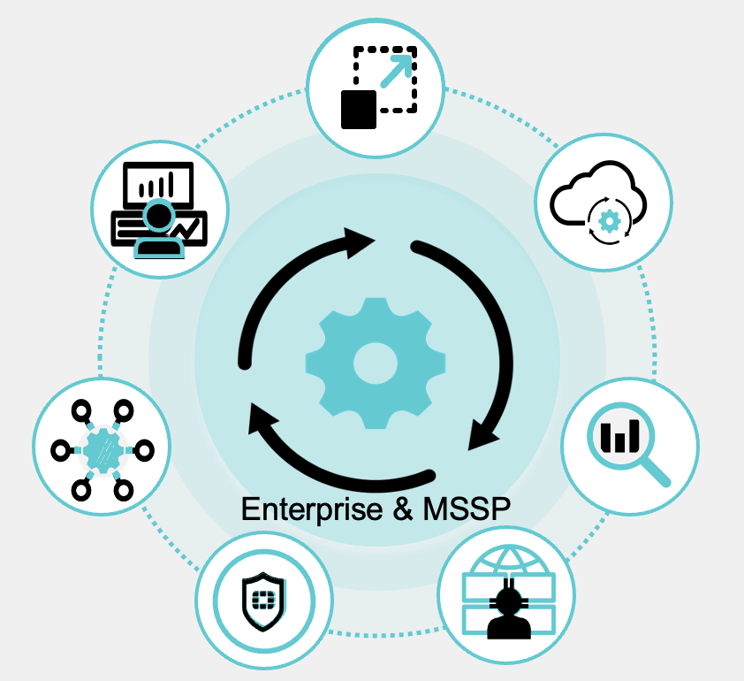
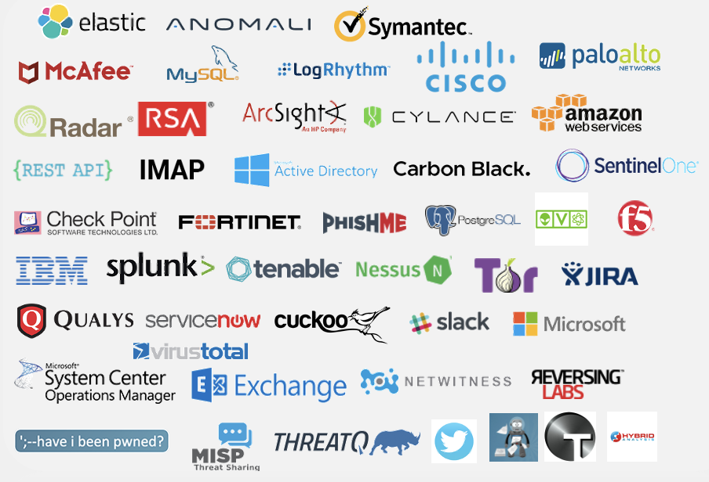
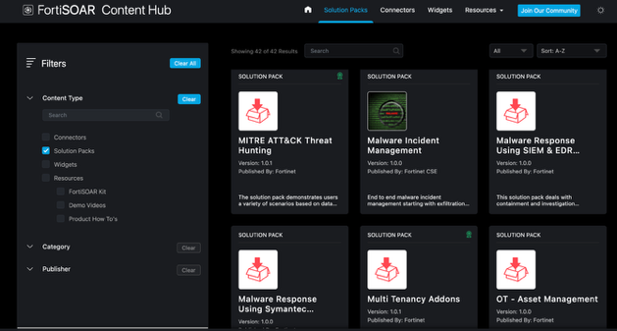
FortiSOAR: Automation across your entire ecosystem
590+ integrations & 800+ playbooks with multi-vendor products
“The champion product when it comes to automation and having the ability to maximize existing tools”
Connectors, playbooks, and more on the FortiSOAR Content Hub
- KuppingerCole SOAR Leadership Compass, 2023
Notes:
Connectivity forms the basis of all SOAR value, and it is a strong point of FortiSOAR.
You name it, we can connect two it and provide 2-way solution packs and playbooks to retrieve alerts, data, issue commands and process responses.
The FortiSOAR Content Hub provides an extensive and growing library of ready-made product content and valuable knowledge via an intuitive, web-based, and in-product portal. You can easily add critical new use cases to your solution by leveraging the 500+ connectors, 800+ playbooks, dashboard widgets, and complete solution packs built by the Fortinet team or contributed by the user community. Demo and how-to videos deliver tutorials and best practices to help you get the most from your automation initiatives.

Slide 36
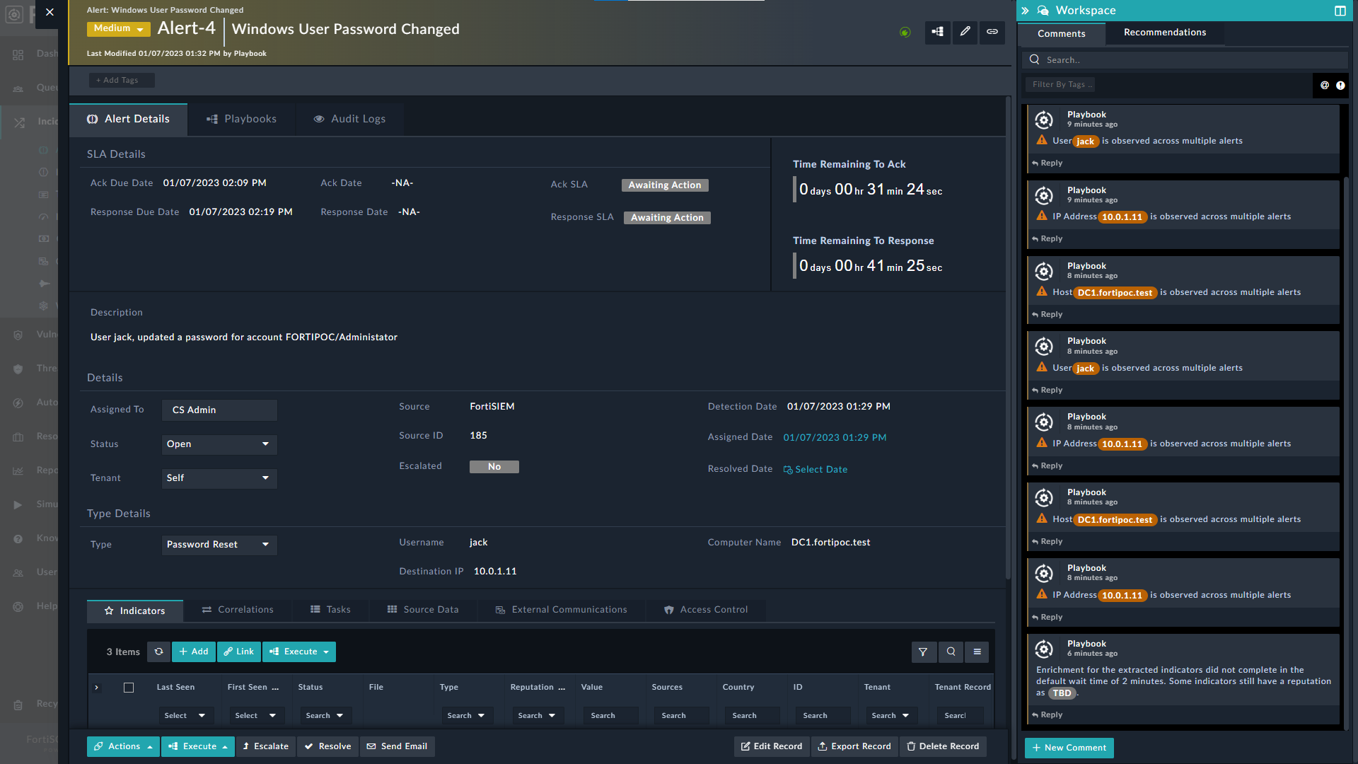
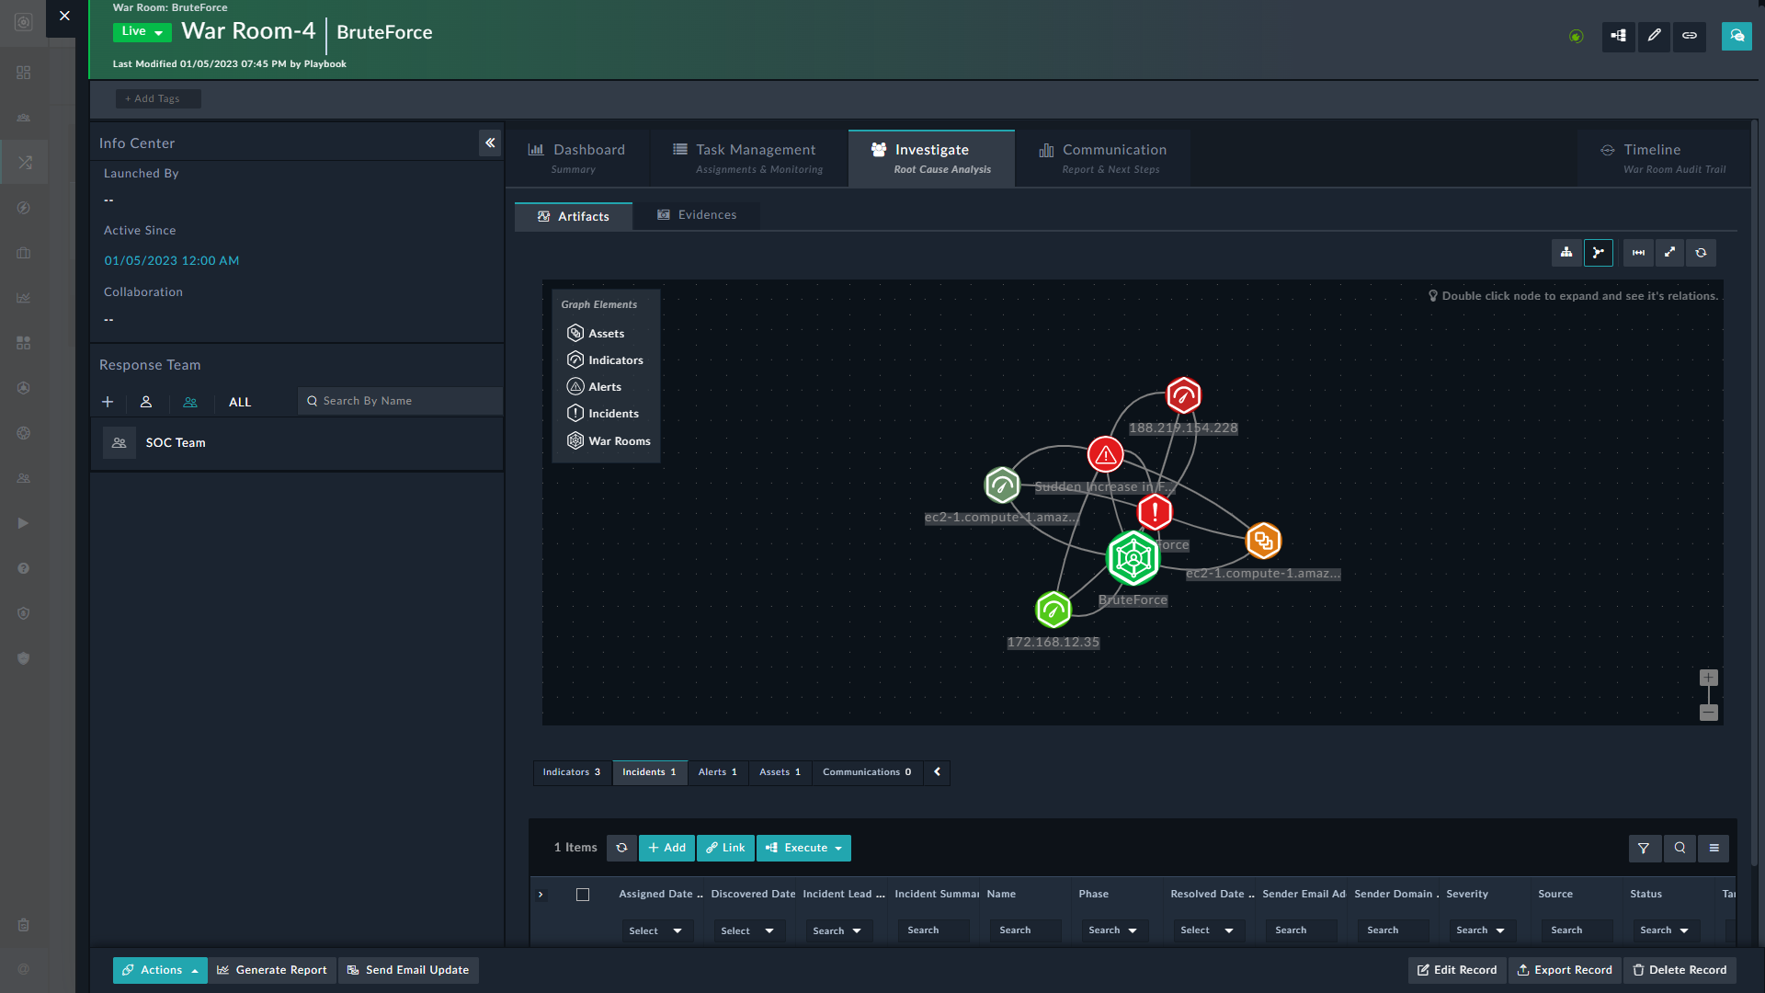
Incident Management
Automatically process alerts
Investigate & respond to incidents
Leverage AI & automation at every step
Robust case management experience
ML-driven playbook recommendations
MITRE ATT&CK mappings
War Room: collaboration, task mgmt, forensics-level logging
Workforce/Ops management - tasks, work queues, shifts; SLA tracking
Role-based access and capabilities
Notes:
FortiSOAR is designed to be the central hub for threat management—automatically triaging, enriching, and assessing alerts from virtually any security product. Routine alerts are automatically handled and closed. Priority alerts are mapped to the MITRE ATT&CK framework and intelligently grouped into incidents for deeper investigation. Recommended playbooks augment rich investigation features, suggest actions, and execute complete remediation steps.
Escalated incidents can activate a full war room that facilitates collaboration and includes detailed forensic logging. And analysts can take action anywhere and anytime via FortiSOAR’s secure mobile application.
FortiSOAR also provides complete workforce management – from task assignments to shift scheduling.
Custom SLAs to monitor SOC and individual performance are simple to create and use for reporting.

Slide 37
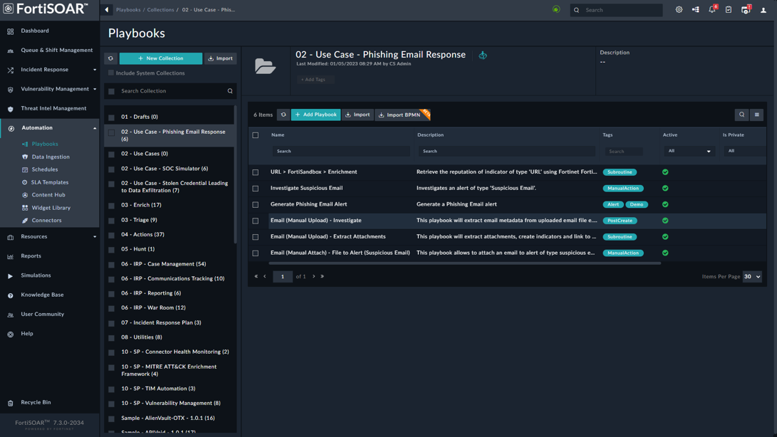
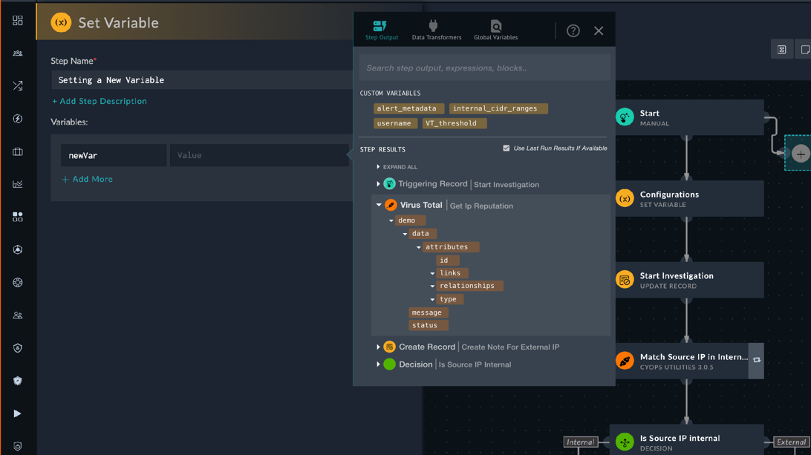
Playbook Creation
Create playbooks and new connectors with ease
Leverage no/low code GUI & recommendations
Simulate and test before deploying
Patented designer provides drag/drop, native language, and python options
Pre-built playbooks & action library speed design
Recommendation engine for stepwise guidance
Reference Blocks give contextual aid, samples
Full CI/CD process support with source control
Simulation tools ensure successful deployment
Notes:
The patented playbook design experience provides a visual drag/drop graphical user interface (GUI) and a low-code rapid development mode that allows users of all types to easily create custom playbooks. The FortiSOAR Content Hub contains hundreds of prebuilt playbooks and automated actions to use as building blocks, while the FortiSOAR Recommendation Engine provides inline step guidance, and Reference Blocks provide contextual aid and samples.
A new CI/CD Solution Pack provides a best-practices framework to automate and standardize FortiSOAR content development with a modern continuous and iterative process to build, test, and deploy content via source control.
The designer function includes full versioning control as well as a simulation engine for testing.
Even the most complicated playbook flows do not require technical coding skills.

Slide 38
Example Case Management Workflow
FortiSOAR
Incident Response Component
Clear
War Room
Clear
Escalate
Alert Source:
SIEM, Cloud, e-mail…
Alert
Incident
Investigate
Connector
Escalate
Document
Report
Hunt
Manual Alert Configuration
Create Tasks
Manual / Automated
Playbooks
Create Tasks
Correlate related objects
Manual / Automated
Playbooks
Connector
Connector
Enrich / Triage /
Aggregation
Collaborate / Enrich / Hunt Enforce / Remediate

Slide 39
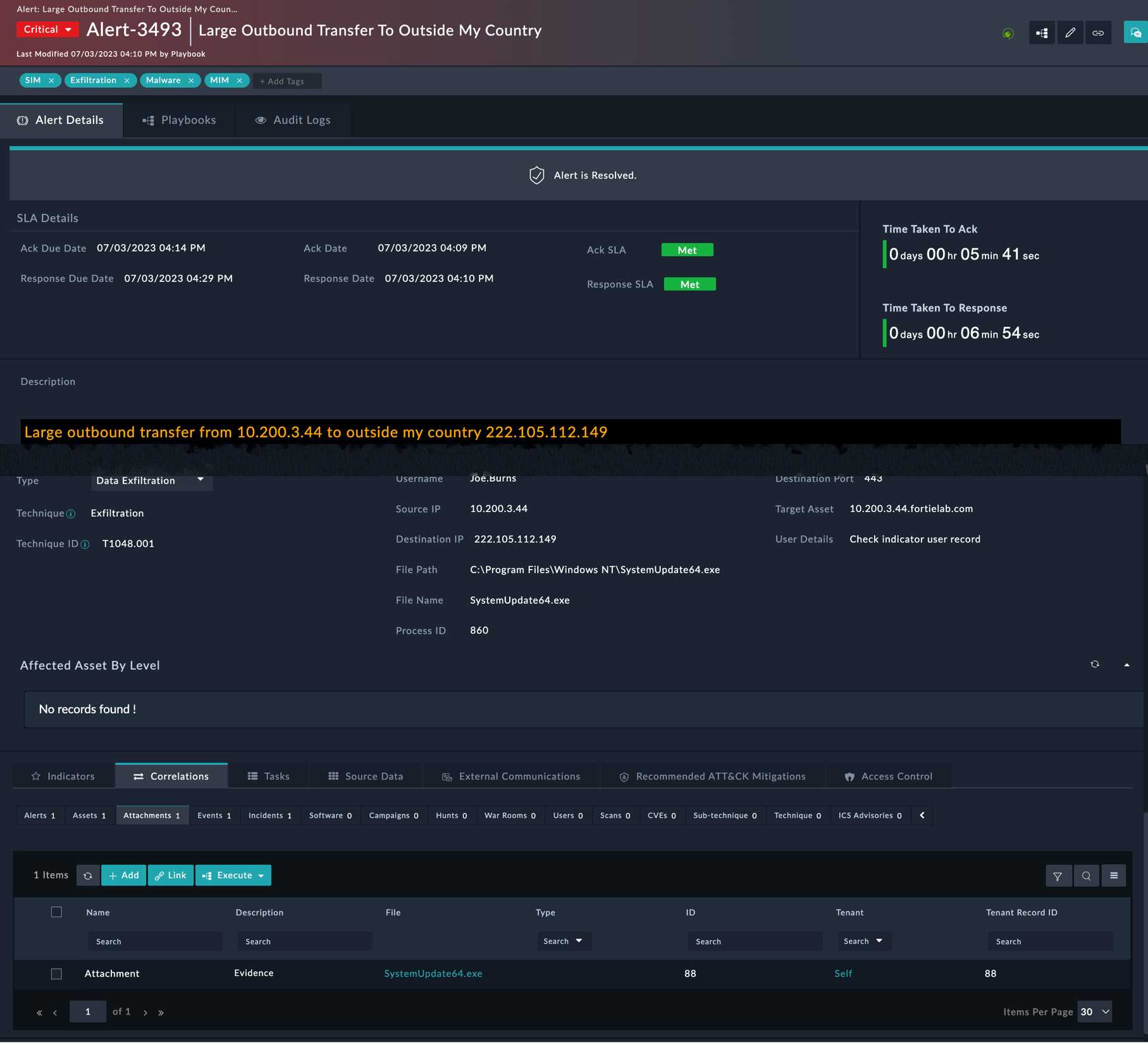
Case Management
Alerts main components
Comments and AI Recommendations
Main Tabs
Playbook execution logs
Alert Attributes (Fields)
Related records and access control

Slide 40
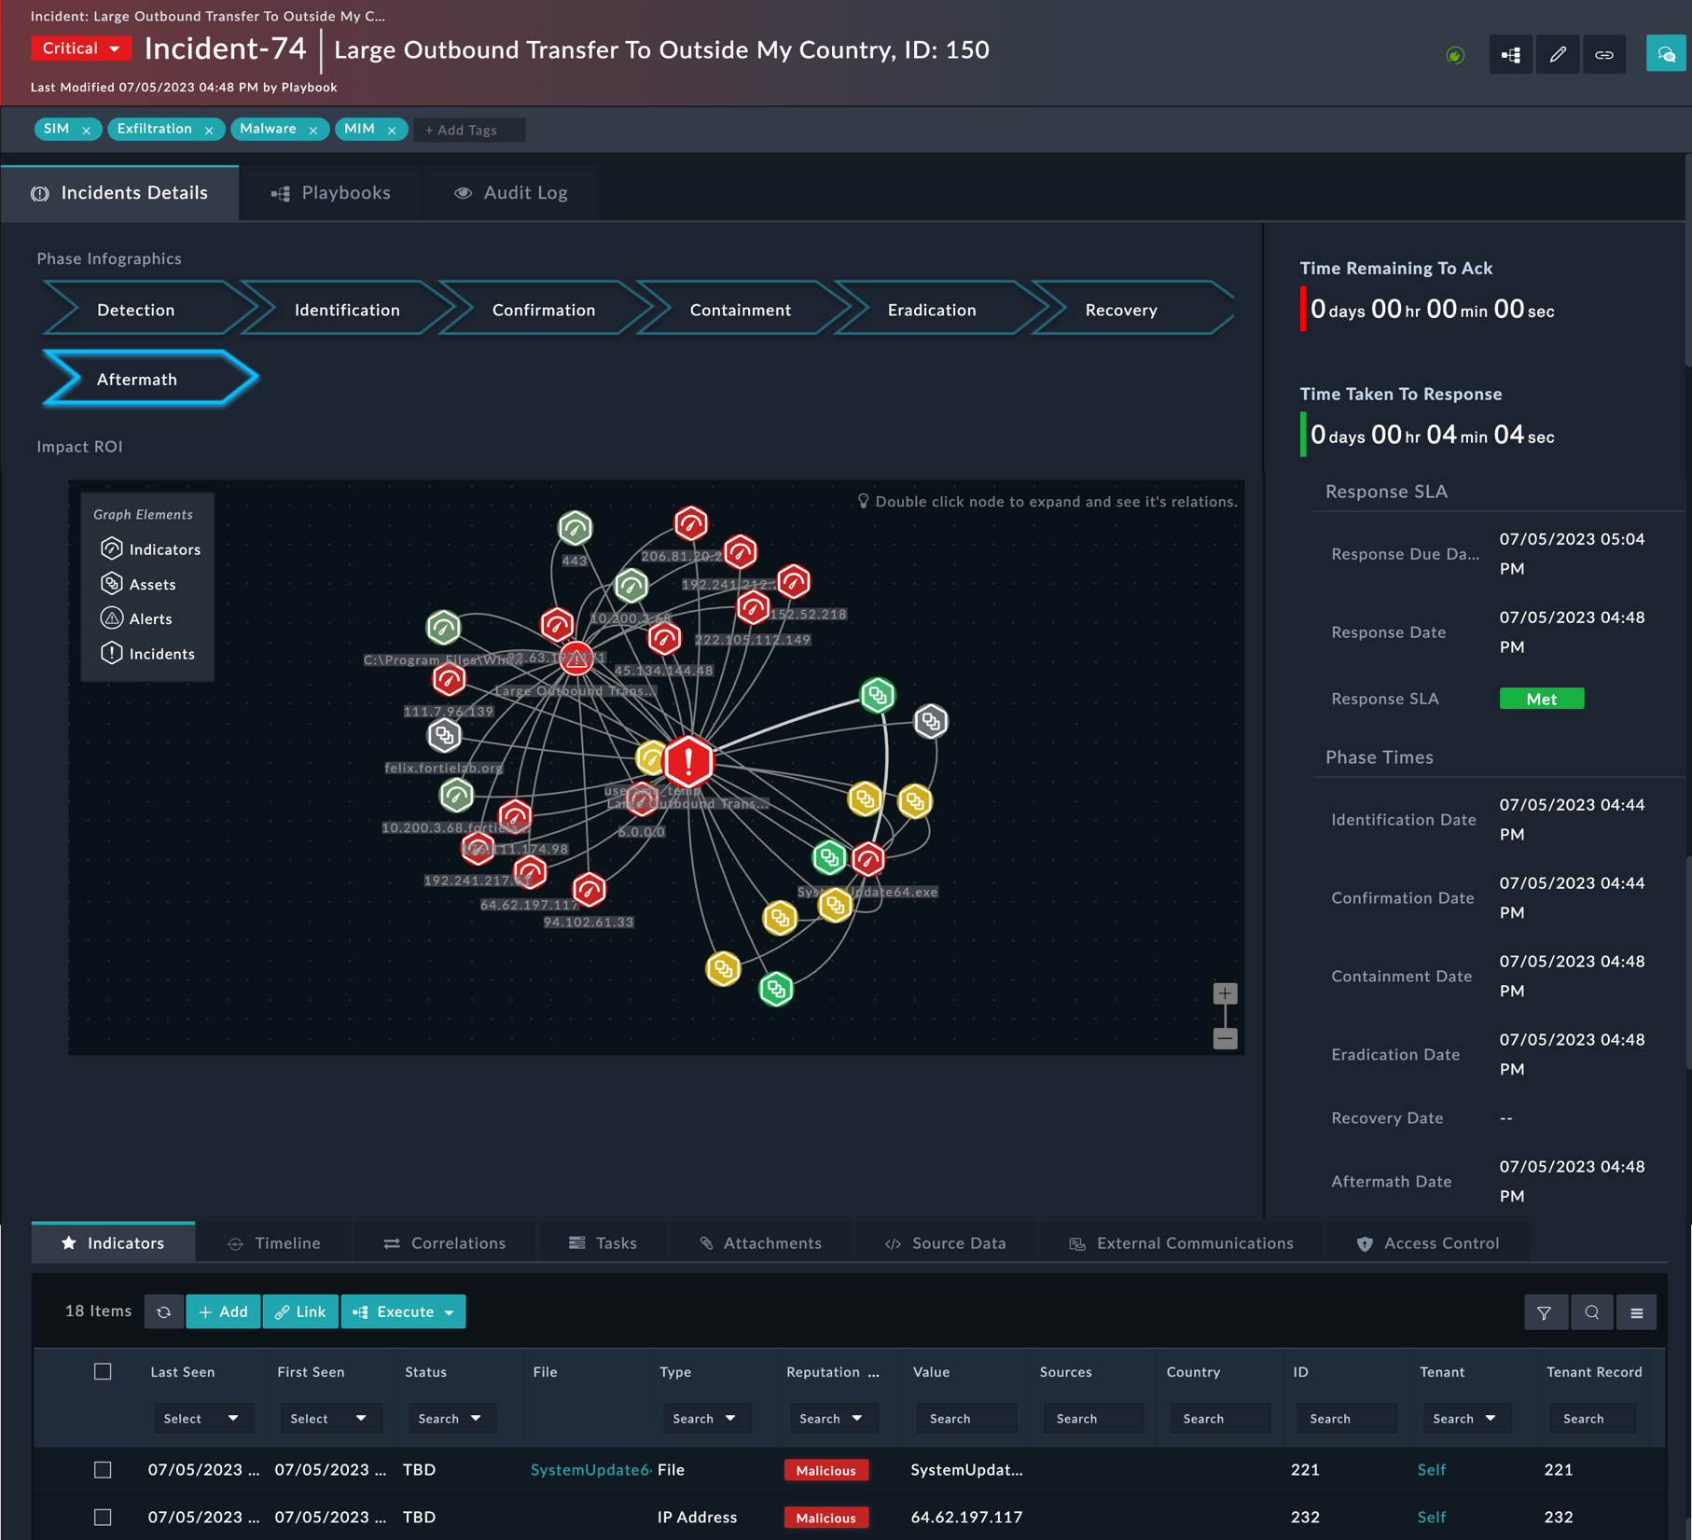
Case Management
Incidents main components
Comments and AI Recommendations
Main Tabs
Playbook execution logs
Incident Attributes (Fields)
Related records, Timeline
and access control

Slide 41
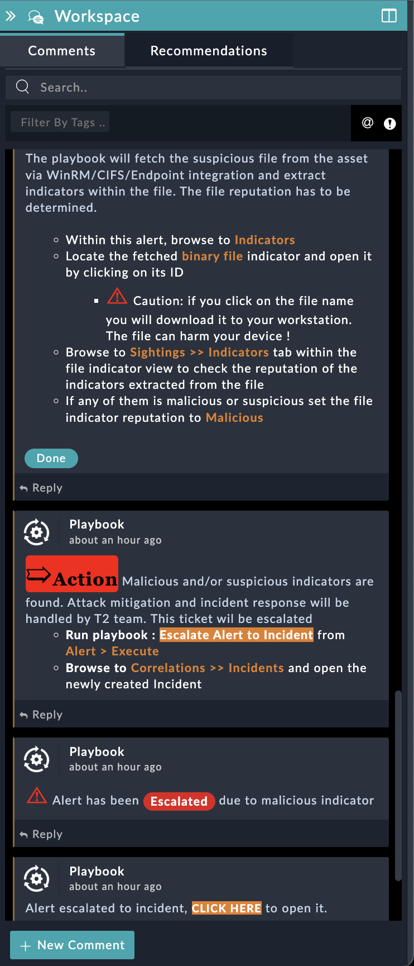
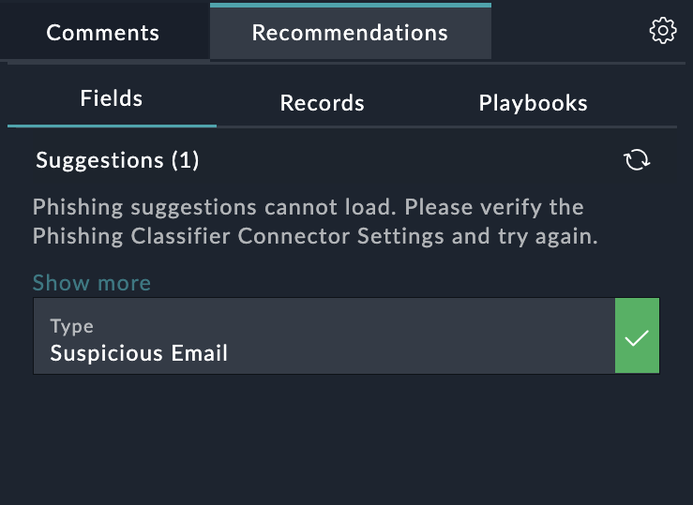
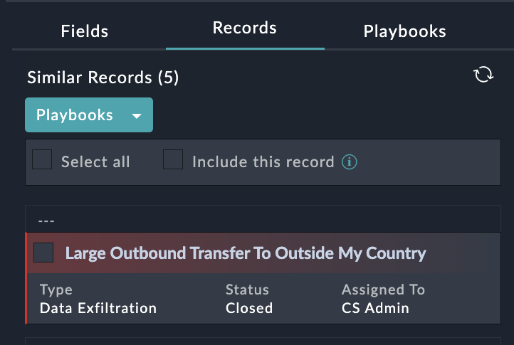
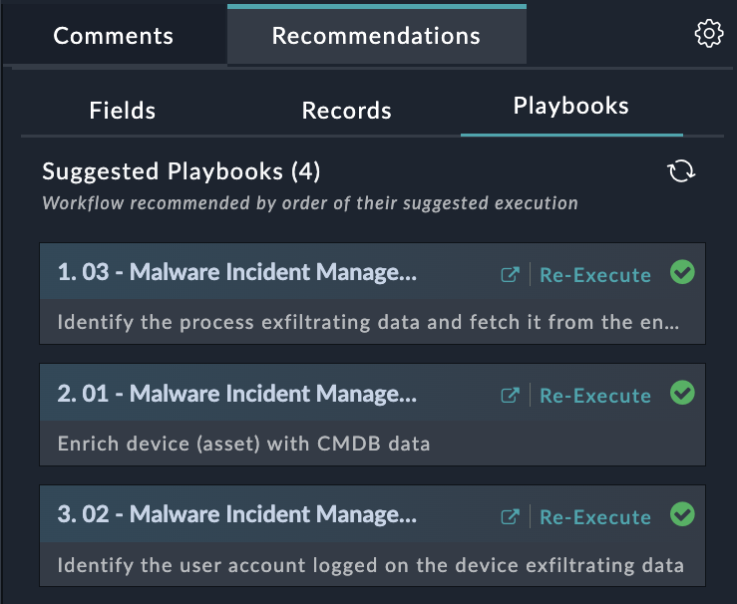

Case Management
Comments and Machine Learning
Comments:
  Rich text record related notes left by playbooks and analysts
  Ability to tag users (similar to an IM software)
  Ability to attach files
Recommended Fields
  AI model to help analysts select the right field value based on the previous records
  Fields recommendation can be applied via playbook
Similar Records
  AI model to fetch records similar to the current
  Found similar records can be linked automatically via playbook
Recommended Playbooks
  Based on previous records (alerts, incidents…) this AI model provides the list of recommended playbooks to run for this record
  Provides a button to execute the playbook
Notes:
intuitive interface optimized for tracking day-to-day security data, such as alerts.
T1s are able to focus on analyzing the data, not collecting the data.
a case ticket can be created, assigned, and tracked until closure to ensure that alert and incident is properly managed.
Modules are easily customizable according to the needs of an organization.

Slide 42
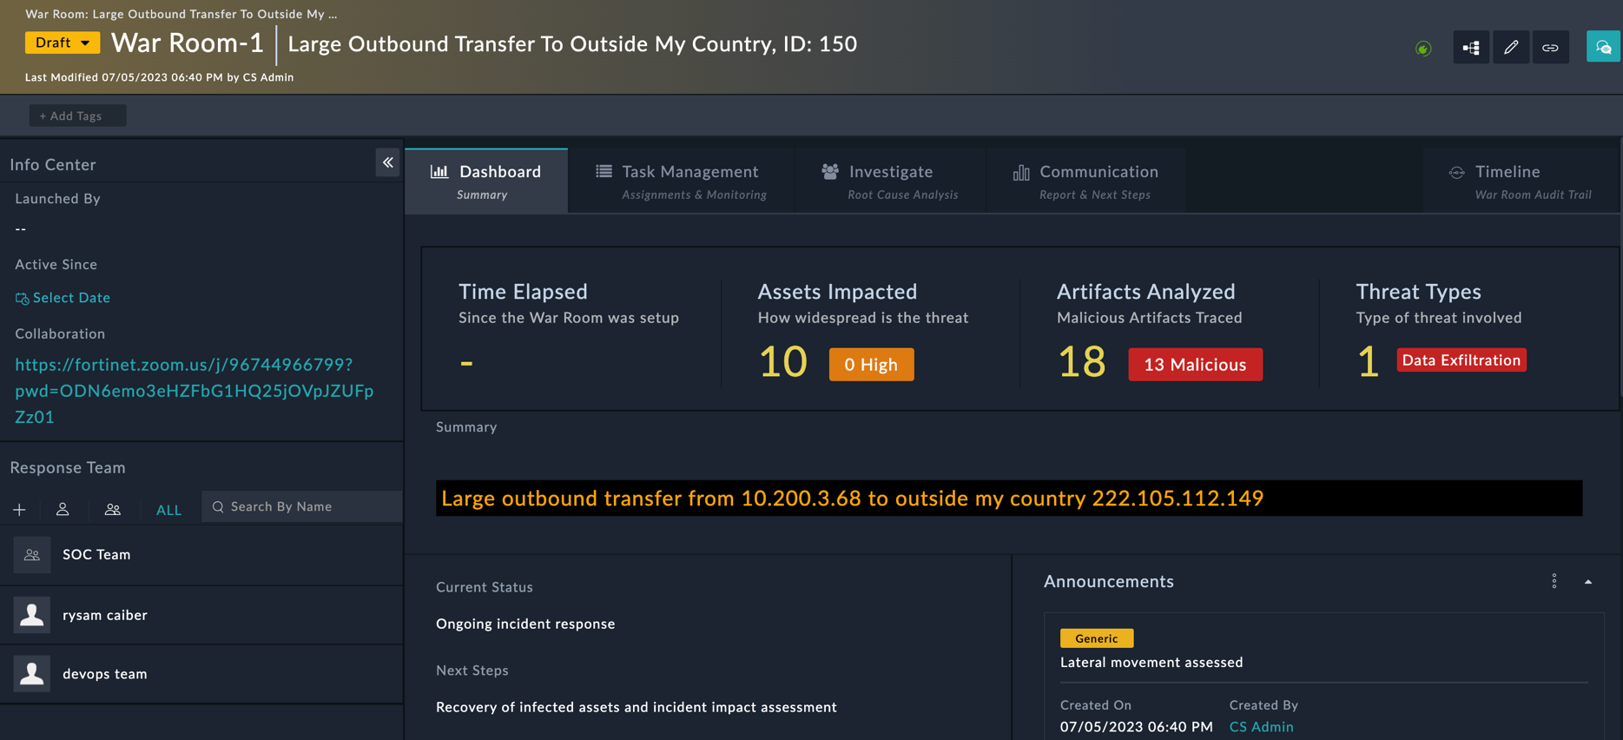
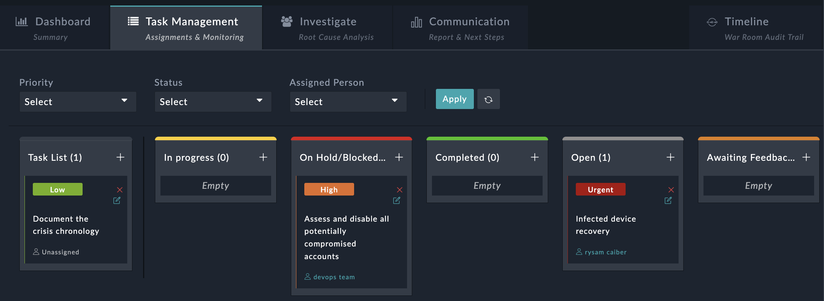
Case Management
Crisis Management with War Rooms
Co-ordinate major incident response from a central page
Centralize associated records
Invite members, collaborate, and assign tasks
Track the tasks across all teams and ITSMs
Send notifications at each milestone
Detailed audit trail

Slide 43
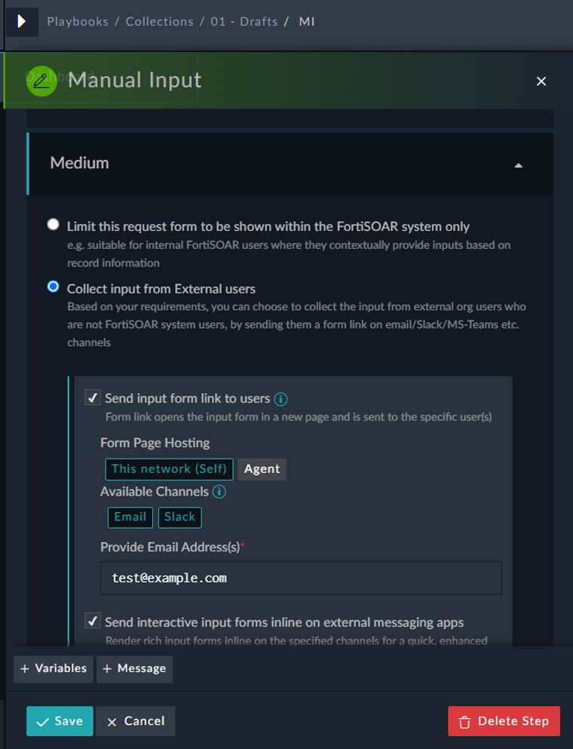
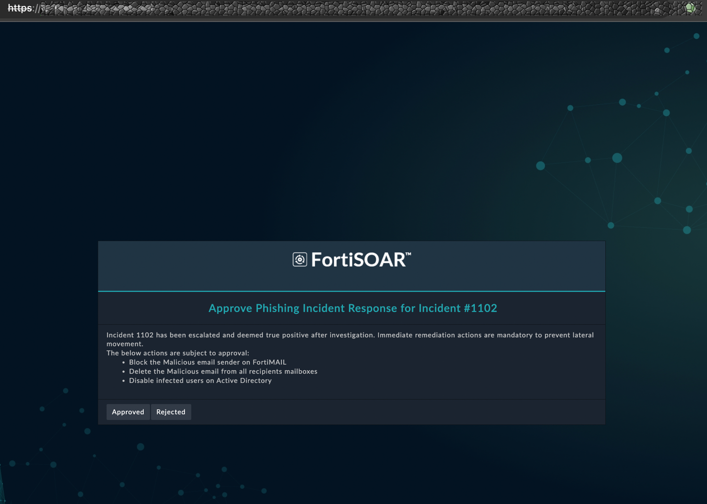
Collaboration
Request manual input via email
Send Email requesting user input or approval via a secure link
Receive Emails as replies or new messages

Slide 44
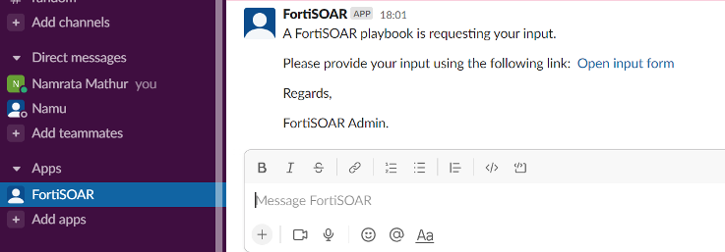
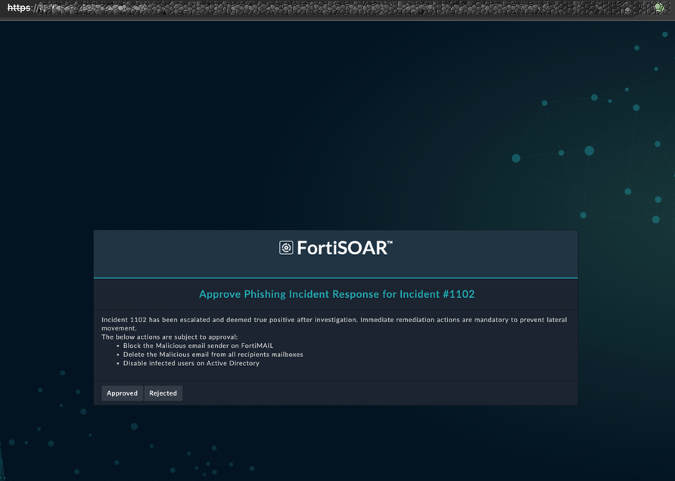
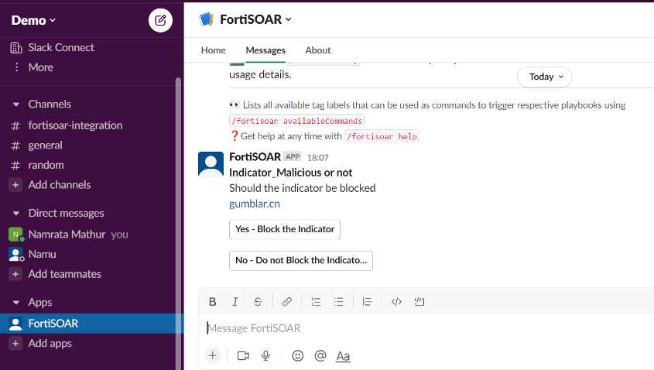
Collaboration
Request manual input from Slack users
Manual input links via IM
Manual input request and result directly from Slack user
Notes:
Incident Workspace has a collaboration panel for teams to have discussions
The platform can is highly customizable and can store, manage, and access documents including incident response procedures, system manuals, documented processes

Slide 45
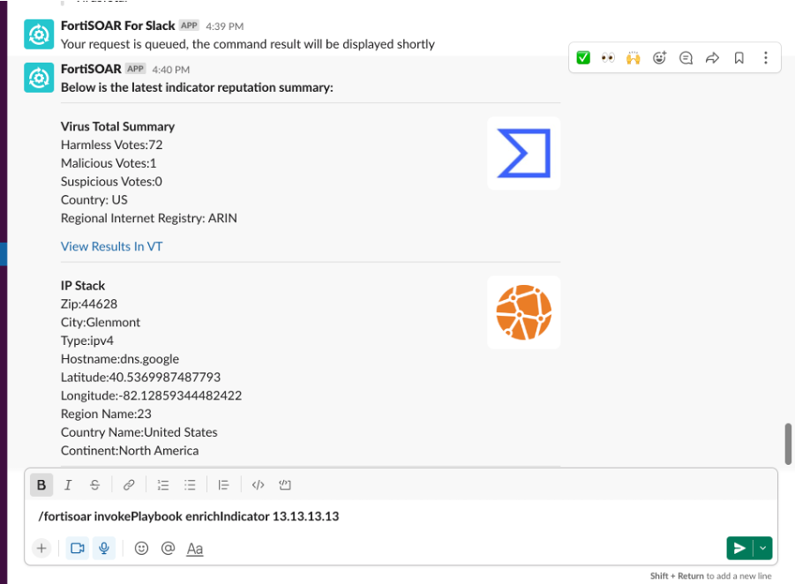
Collaboration
Execute actions on FortiSOAR from Slack
Triggers a playbook from Slack such as:
You can run any playbook by simply tagging it, so the command above runs the playbook having the tag enrichIndicator
Formatted returned value is displayed within Slack window
/fortisoar invokePlaybook enrichIndicator 123.32.3.5
Notes:
Incident Workspace has a collaboration panel for teams to have discussions
The platform can is hghly customizable and can store, manage, and access documents including incident response procedures, system manuals, documented processes

Slide 46
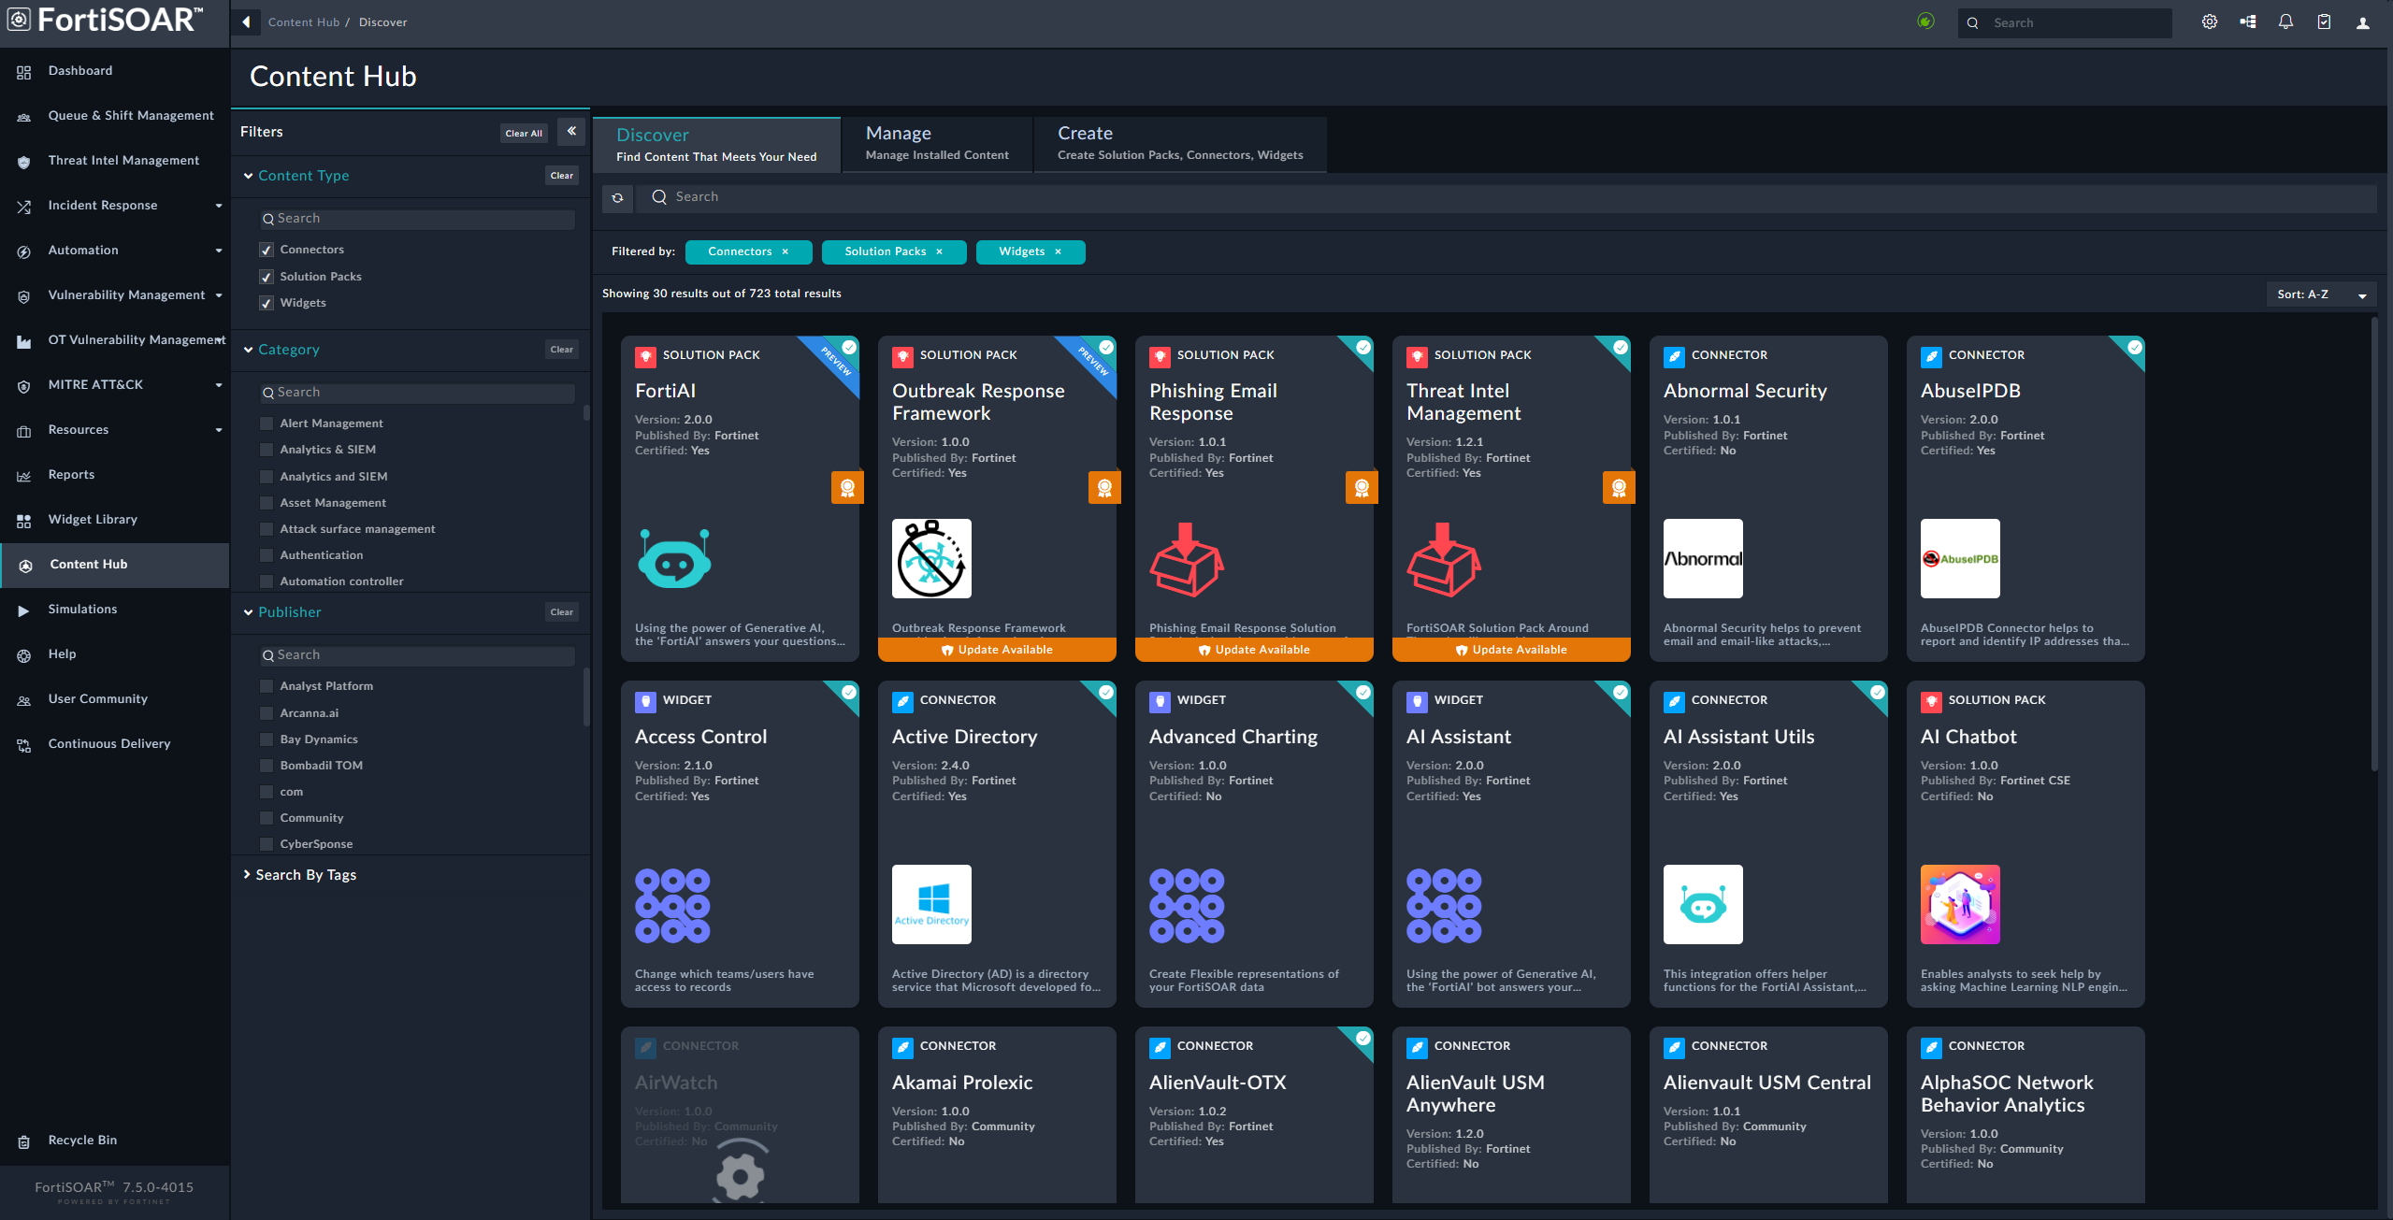
Content Hub
Connectors, Widgets, and Solution Packs
Connectors, Widgets, and Solution Packs are components that are installed independently of the FortiSOAR operating system to enable additional functionality.
Each of these are installed via the FortiSOAR’s Content Hub, which is regularly updated.
The currently available components can be viewed here:
https://fortisoar.contenthub.fortinet.com/

Slide 47
Orchestration & Automation: Connectors
How FortiSOAR integrates with other systems
Threat Intelligence
SIEM
Connectors enable FortiSOAR to integrate with external systems, such as cyber security tools.
Connectors are written in Python and
FortiSOAR includes a built-in IDE.
Connectors enable the ability to send and receive data from these external systems, to perform actions, such as:
  Ingest alerts, indicators, and assets
  Enrich indicators, and assets, such as
    Query threat intelligence for indicator rating
  Contain incidents
    Quarantine endpoints
    Block IP addresses
  Remediate incidents
  Search for data
    Perform threat hunts for indicators
API
API
Directory Service
Connector
Connector
Email Server
Connector
Connector
LDAP
IMAP
API
Connector
Connector
API
Ticketing System
FortiSOAR
Sandbox
Connector
Connector
API
API
Firewall
EDR

Slide 48
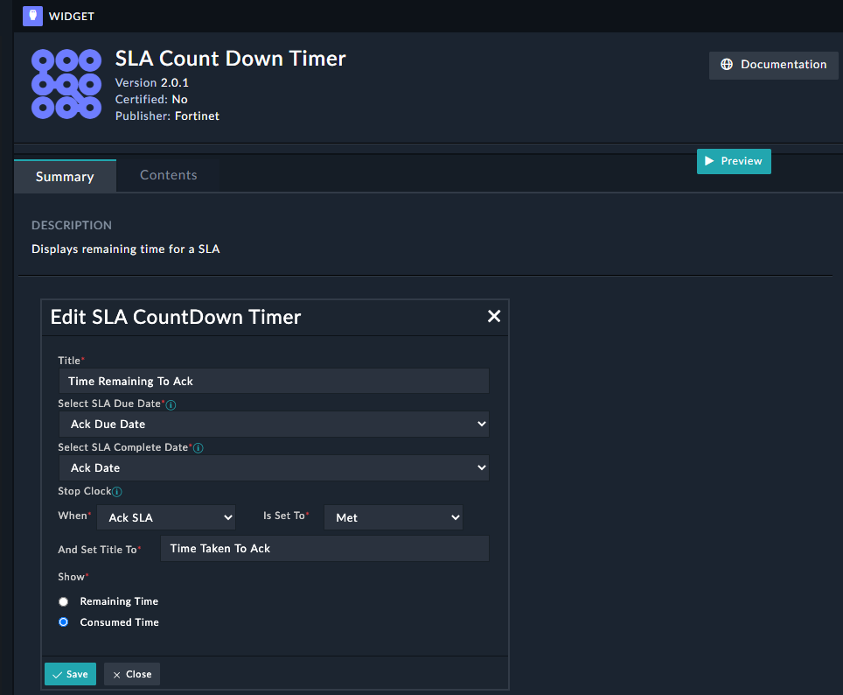
Orchestration & Automation: Widgets
Enabling more from FortiSOAR’s GUI
Widgets are installable components to populate the UI, dashboards, and reports with visualisations and tools to enable an analyst to visualise and manage data and records in FortiSOAR.
Widgets are written in JavaScript and CSS.
Some example widgets include:
  AI Assistant
  Record Summariser
  ROI Calculator
  SLA Count Down Timer
  Task Management
  Time Series Charts

Slide 49
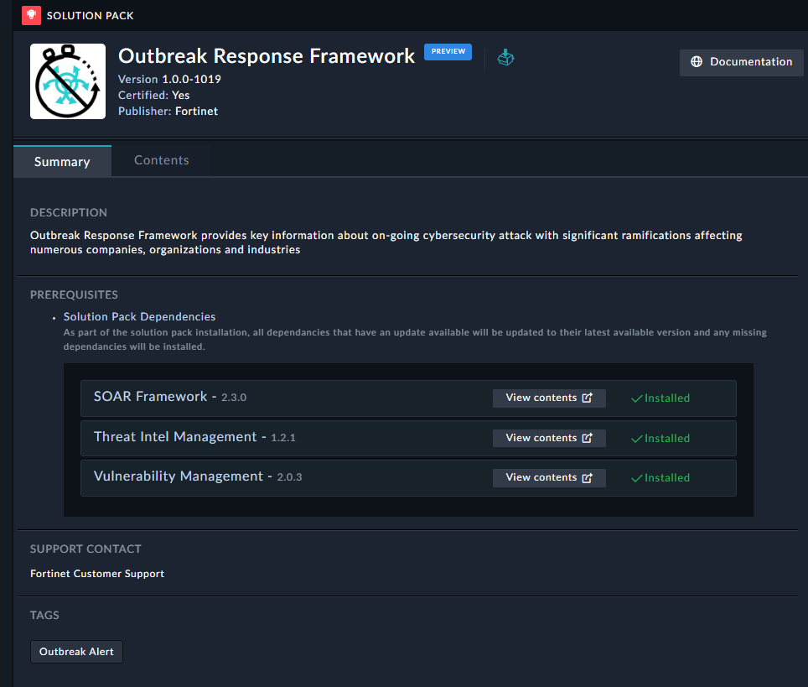
Orchestration & Automation: Solution Packs
Common Pre-packaged Use Cases
Solution Packs are example curated sets of connectors, playbooks, widgets, and modules that provide a demonstration of a particular use case that can be performed by FortiSOAR.
These can be used to provide a sample framework which analysts can customise to meet their individual requirements.
Example Solution Packs include:
  Automated Employee Onboarding
  MITRE ATT&CK Enrichment Framework
  MITRE ATT&CK Threat Hunting
  Multi-Tenancy Addons
  Outbreak Response Framework
  Phishing Incident Management

Slide 50
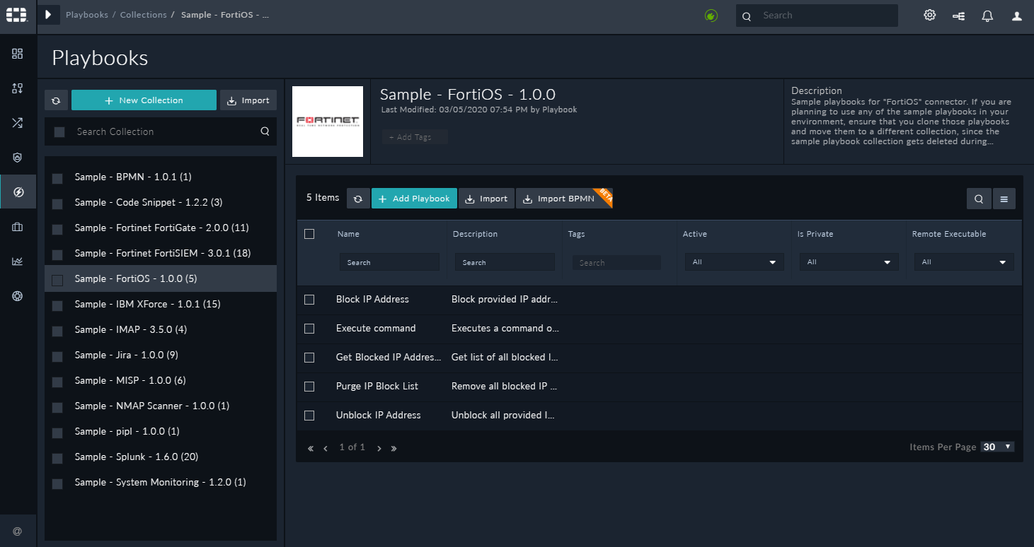
Orchestration & Automation: Playbook Collections
Collections
Playbooks are the heart of FortiSOAR.
They are used to perform nearly all of FortiSOAR’s interactions.
Playbooks can be grouped into collections (folders).
When installing a Connector or Solution Pack, a sample collection is normally
installed.
Playbook Collections
Many Preconfigured Playbooks

Slide 51
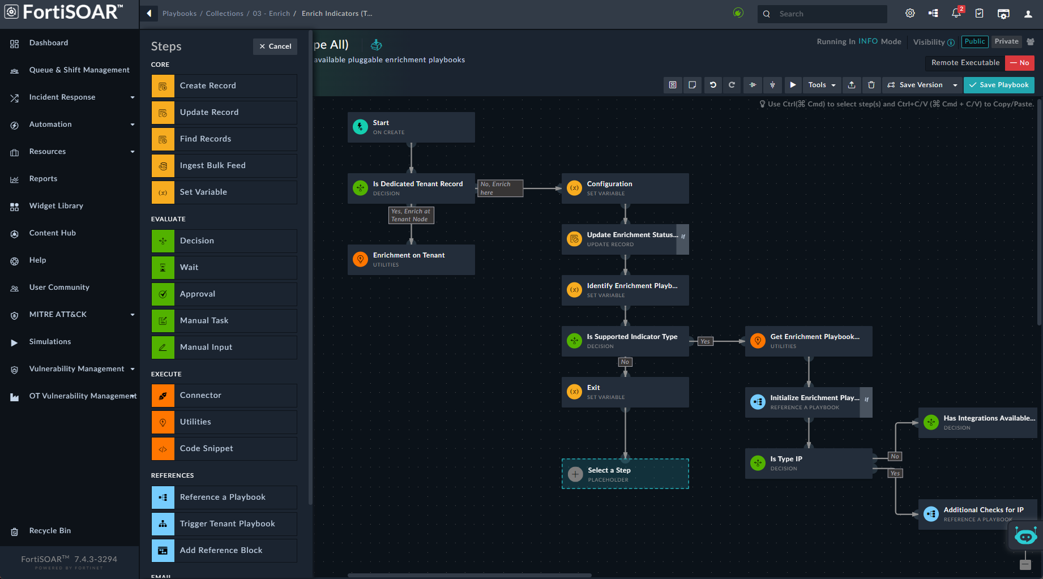
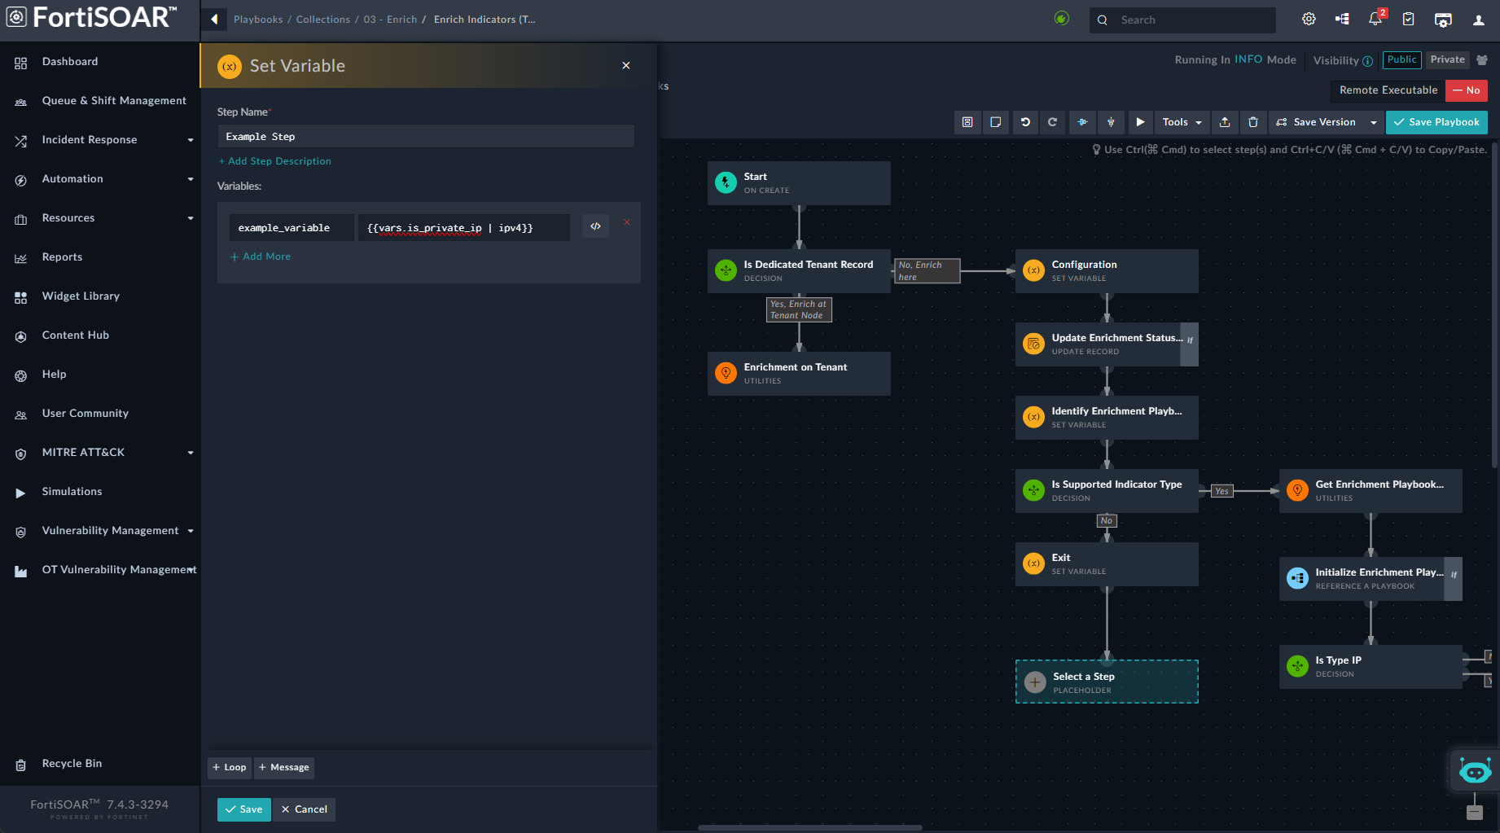
Orchestration & Automation: Simplified Playbook Building
Drag and Drop Building
FortiSOAR’s visual playbook designer enables for the quick creation of playbooks, by drag and drop step blocks.
Playbooks can be built from simple to complex, and the calling of other playbooks enables reusable modular actions.
Inside these blocks data can be used and implemented through Jinja expressions. This includes refering back to data from previous blocks.

Slide 52

Orchestration & Automation: Simplified Playbook Building
Low/No Code Playbook Designing Experience
To reduce assumed and actual complexities involved in building playbooks, such as knowing Jinja, FortiSOAR includes lots of inline help and out-of-the-box aids to help design playbooks without worrying about any coding experience needed!
100+ readymade functions and data transformers to search, test and add in a click
Ability to reference hundreds of readymade reference playbook blocks for common micro use cases.
For example:
  Is this IP internal/external
  Enrich using indicator using Virus Total

Slide 53

AI: Playbook Suggestions
Based on past threats and investigations run on them, the ML framework suggests the most suitable order of playbooks and workflows to execute
Once, executed, it maintains the state of which suggestions have been already executed and what remains to be executed or reviewed
Notes:
PMDB Info-ID: 21461 (fortinet.com)

Slide 54


AI: Generative AI Integrations
Analyst Messages
AI Messages
Ask one or multiple AI anything
Have an actual conversation with AI
Notes:
This is a sample Two Pictures with Captions slide ideal for including two pictures with brief descriptive statements.
To Replace the Pictures on this Sample Slide (this applies to all slides in this template that contain replaceable pictures)
Select the sample picture and press Delete. Click the icon inside the shape to open the Insert Picture dialog box. Navigate to the location where the picture is stored, select desired picture and click on the Insert button to fit the image proportionally within the shape.
Note: Do not right-click the image to change the picture inside the picture placeholder. This will change the frame size of the picture placeholder. Instead, follow the steps outlined above.
Tip: use the Crop tool to reposition a picture within a placeholder. From the Picture Tools Format tab on the ribbon, click the Crop button. Click and drag the picture within the placeholder to reposition. To scale the picture within the placeholder (while Crop is active), grab a round corner handle and drag to resize. Hold Shift key to constrain picture aspect ratio when resizing.

Slide 55
Example Scenario: Generic IPS Incident
3rd Party Product
Auto
Incident Created
Auto
Auto
Auto
Auto
Auto
Low or Blocked
Save Incident to Record for log
Report Creation
Case Closed
Determine Severity
Auto
Auto
Auto
SIEM
Indicident to SOAR
High/Medium or Not Blocked
Auto
Auto
Start Analysis
Check Default Block List
Auto
External
Threat Intelligence
Check Reputation on External IP
Auto
Query information related to security systems in operation and collect additional information
Data Enrichment
Applies to every scenario
Differs on IPS scenario.
YES
No
Below threshold
Is it the type that requires human analysis?
Check Threshold
Auto
Over threshold
Create CASE and provide analysts
Human
Response according to type
Auto
TP
No
Block IP or Create Block List
Human
Auto
Auto
IP Block
Is it an internal Asset?
TP/FP Analysis
Human
YES
Auto
Generating and Delivering Reports - 1
Additional Logs Check
Block recommendation
Human
confirmation request
FP
Auto
Add Info to CASE
Check SIEM Events
on-site action
Case
Closed
Auto
Human
Auto
Human
security training

Slide 56
Example Scenario: Collecting Automation Asset Risk
Asset Info
CSV
Upload
Auto
Auto
Auto
YES
Auto
Auto
Human
Auto
Auto
Create Asset in SOAR
IoC Extraction
Search CVE by using CPE
Check if CVE Exists
CASE Creation
Wait Until the Asset is Safe
Generate and deliver reports
Exit
SOAR
No

Slide 57






POC Process - Key Expectations #1 – Automation
1~5 Mins
1~5 Mins
1~10 Mins
1~10 Mins
1~10 Mins
0~20 Mins
5~10 Mins
10 ~ 70 Minutes
Human
!!
3rd Party
Solutions
Using FortiSOAR Saves 99%
Time Efficiency
TOTAL TIME
Start to Finish
Alert Creation
Type Analysis, Prioritization
Indicator Extraction (Attacker IP, Domain etc)
External Reputation Analysis
Geolocation IP Analysis
Whois IP Analysis
Logs
linkage analysis
Apply blocking policy
FortiSOAR
Automation
~ 1 Minute
Save Incident Response Time
Data Centralization & Migration
Process Standardization
Enrichment & Correlation data View
Automation processes
Single Pane of Glass
Standardized Business Process
Automatic data augmentation
Icon made by Sherzod Mirzaakhmedov from www.flaticon.com

Slide 58

External Facing Resources
Fortinet Documentation Site:
https://docs.fortinet.com/product/fortisoar
Admin Guides
Reference Manuals
Installation Guides

